Slide 1
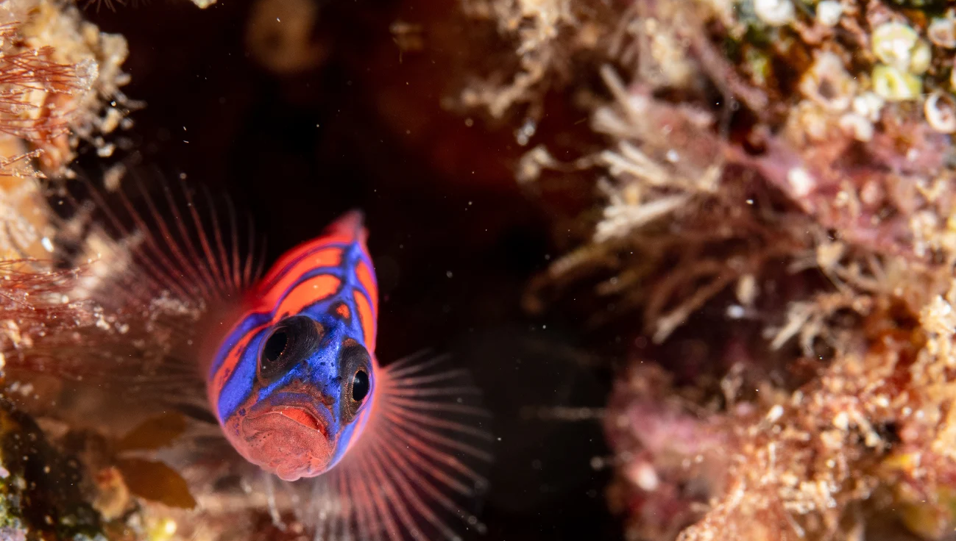
Evaluating the effects of predation risk on reproduction of a temperate reef fish
George Jarvis
Master’s Thesis Defense | May 7, 2019
Notes:
Interested in the effects of environmental factors, such as predation risk, may influence prey fitness over time

Slide 2
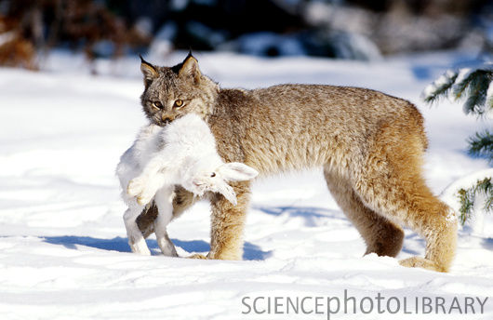
Predation influences prey fitness
Two types
Lethal: direct removal of reproductive individuals
Sublethal: predation risk alters reproductive behavior
Maximize current or future fitness?
Many studies on risk in terrestrial and aquatic taxa
Risk from predators
Offspring
Behavior
Physiology
Survival probability
Parent
Reductions in fitness
www.geocaching.com
Parental investment
Reviewed by Peckarsky et al. 2008
Reviewed by McArthur et al. 2014
Adapted from Clark and Ydenberg 1990
Notes:
Been assumed that the lethal effects of predators are the primary type of predation that drive population dynamics in prey
It has been shown that the sublethal effects of predators can have equal, if not greater effects on prey communities than lethal effects, because they often affect more than one individual in a population
(when text changes color) I’m really interested in these sublethal effects of predators b/c they affect more than one individual in a population
When faced with risk, prey have to decide whether to maximize current or future fitness
Depends entirely on the survival probability of a reproductive individual
When high likelihood of survival = low parental investment, b/c will likely survive to breed again
Low likelihood of survival = lots of investment, b/c there will likely not survive to reproduce again
In the context of risk ,
d. well-studied in terrestrial and aquatic systems, but lack of equivalent studies in marine fishes
a. In field: decreased herbivory in response to mimics = reduced fitness?
b. In lab, prey act differently, predators act differently, not super realistic
though studies in lab reflect tend to follow theory of reproductive plasticity mentioned before
T: One fish species that is attractive for studying the effects of risk on reproduction is the bluebanded goby

Slide 3
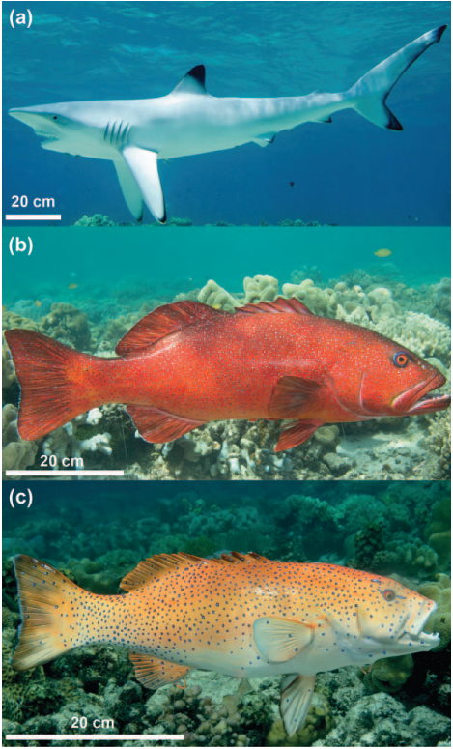
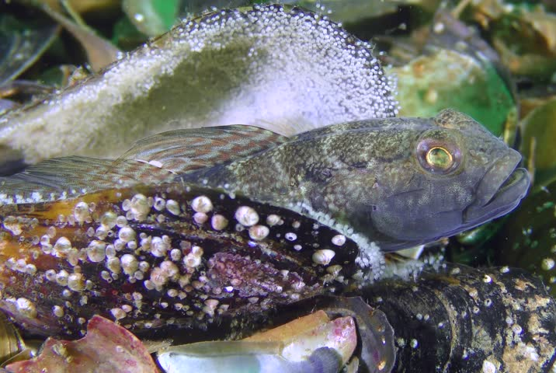
Few studies on risk in marine fishes
Limitations of previous work
Field experiments mostly correlative
Lab experiments may be unrealistic
Test with model organism in the field?
Kurakin Alexander
Rizzari et al. 2014, Catano et al. 2016
Magnhagen 1990
Notes:
1. Has been work done in field and lab, but studies don’t often measure fitness changes directly
In field: common to use predator mimics to ensure visual predator presence
Often misinterpret the effects of predators because only one fitness response (e.g., foraging, movement), which may not capture the full scope of the effects of risk
b. In lab, prey act differently, predators act differently, not super realistic
though studies in lab reflect tend to follow theory of reproductive plasticity mentioned before
c. More realistic response with more natural behaviors for prey and predators
T: One fish species that is attractive for studying the effects of risk on reproduction is the bluebanded goby
Extra notes, might not use
Field experiments mostly correlative (herbivores grazing less in high risk settings = lower fitness?)
Lab experiments lack biological realism (magnhagen studies)
But lab studies have shown that response of fish to predators relies heavily on their life history (reproductive plasticity), which is consistent with evolutionary theory
Potential models to study risk in marine fishes?

Slide 4
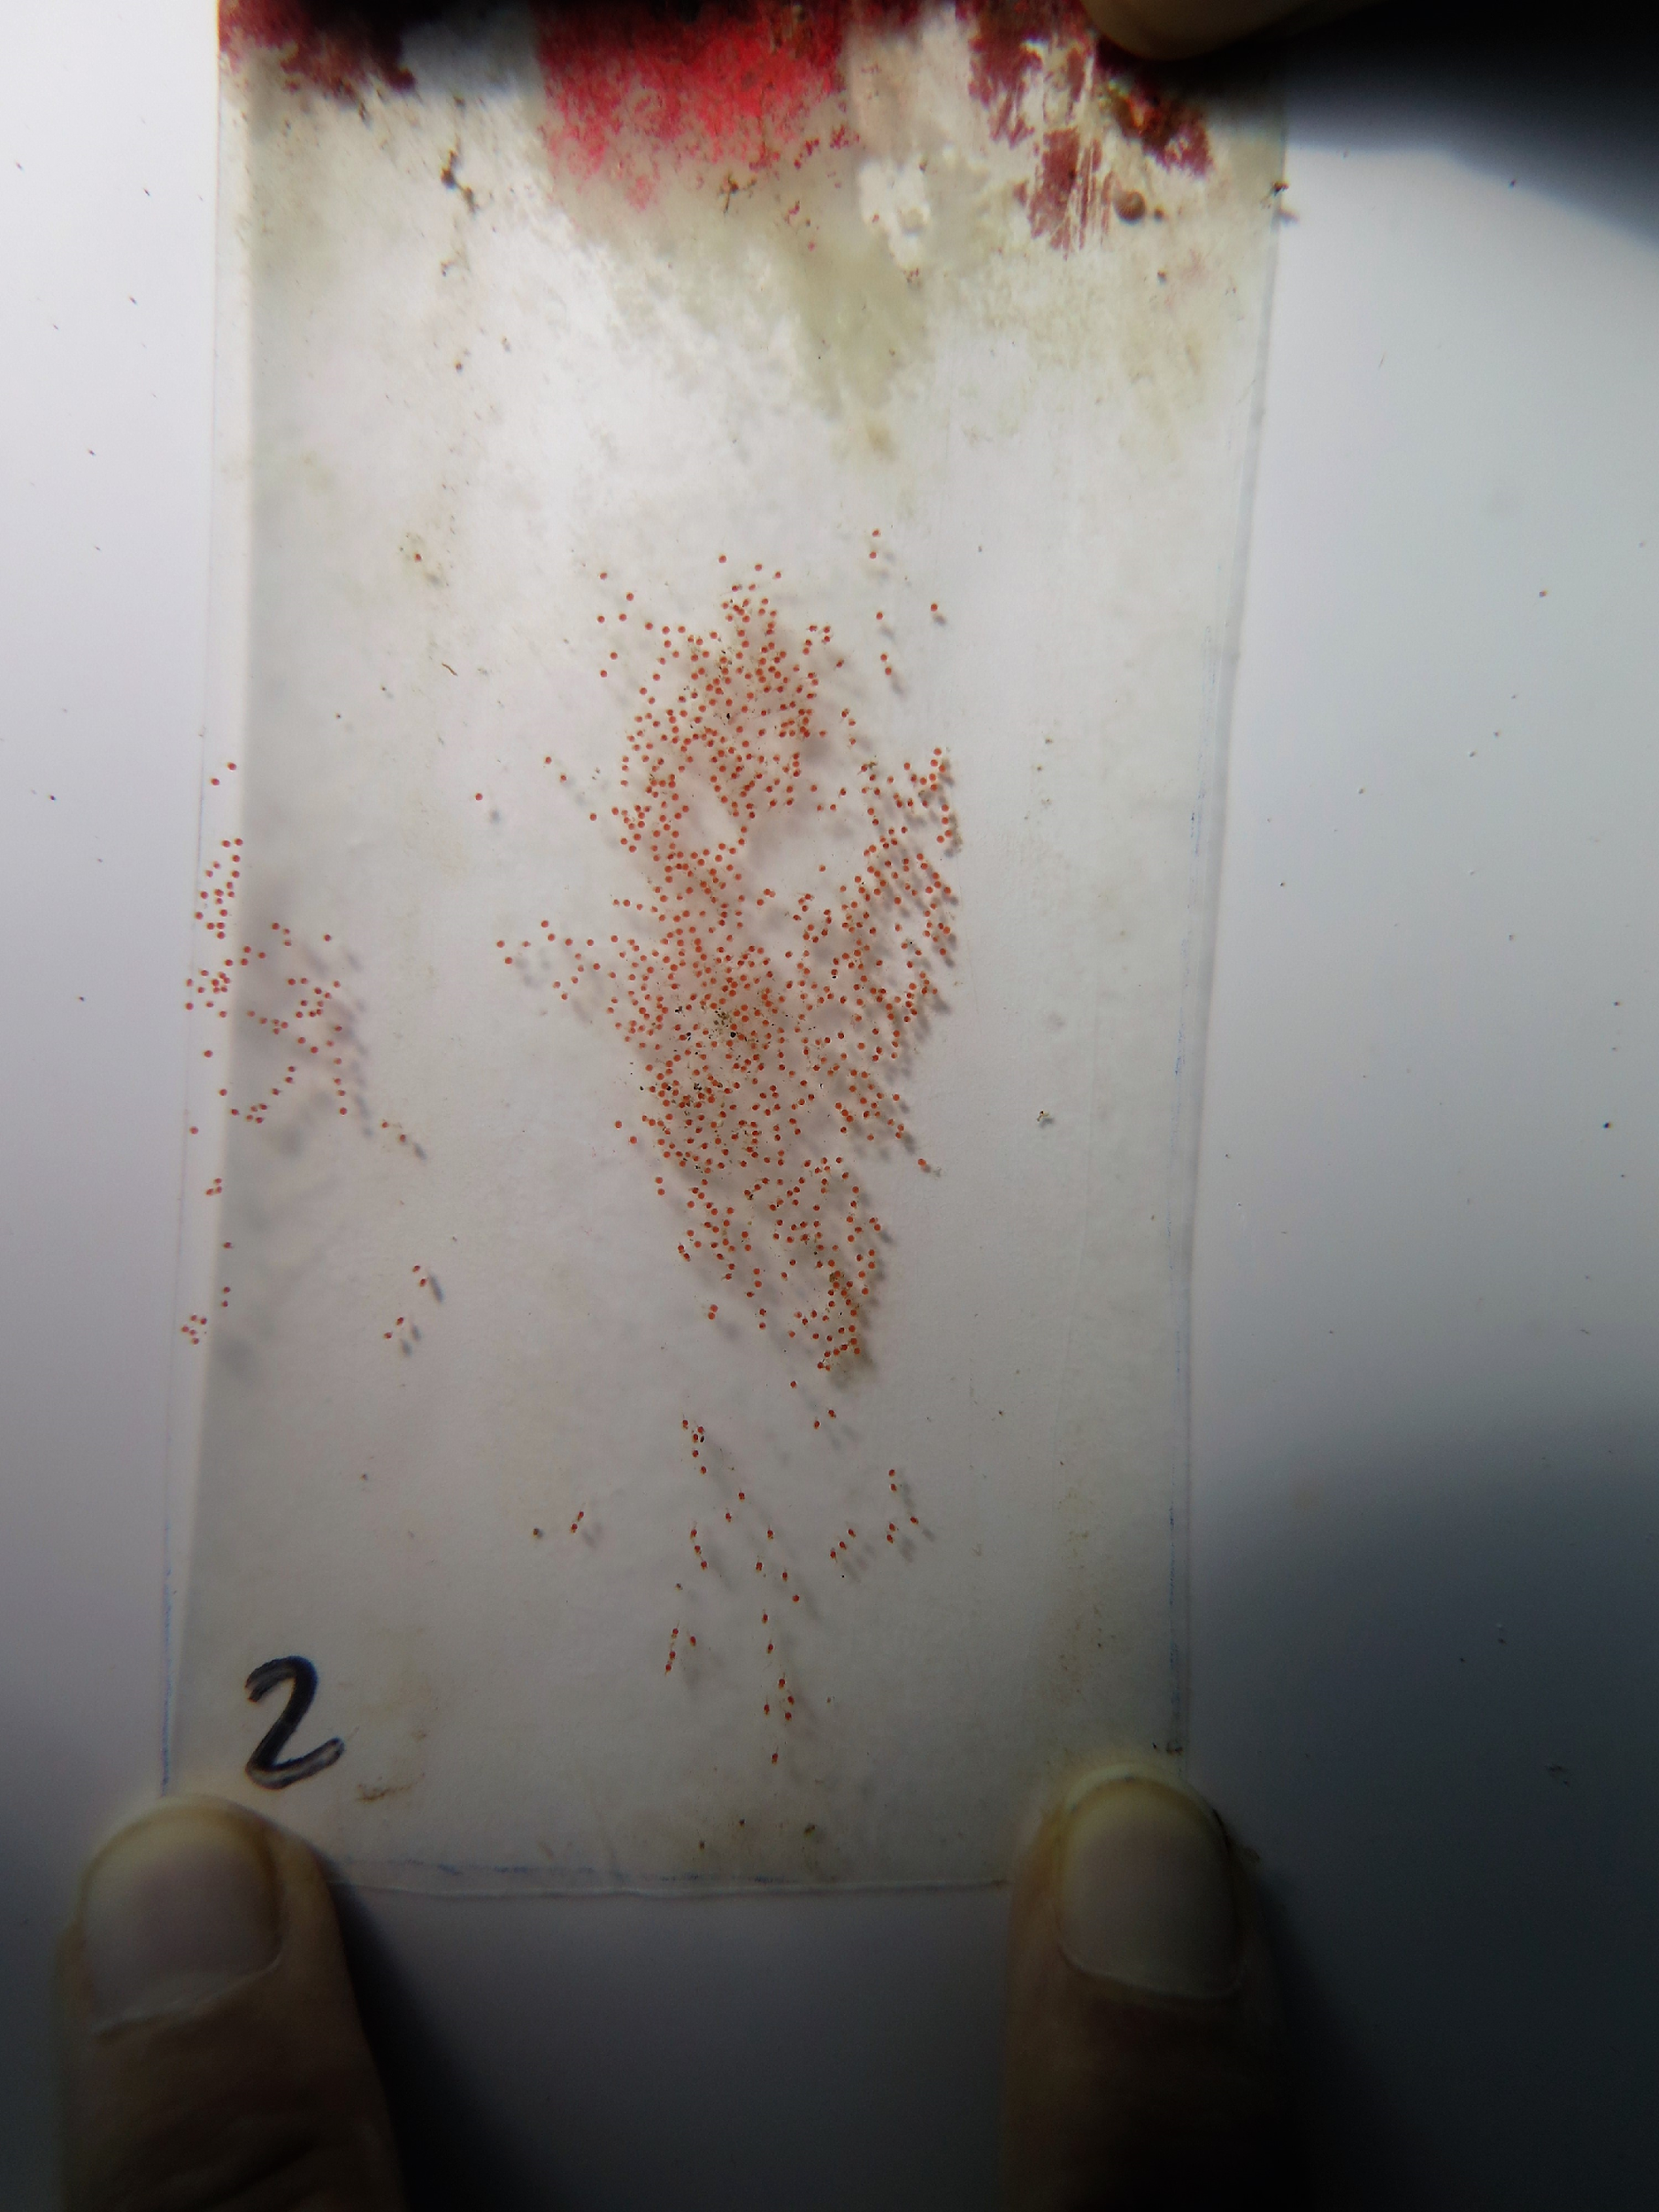
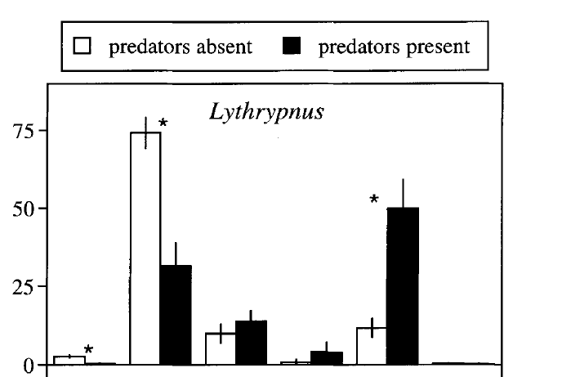
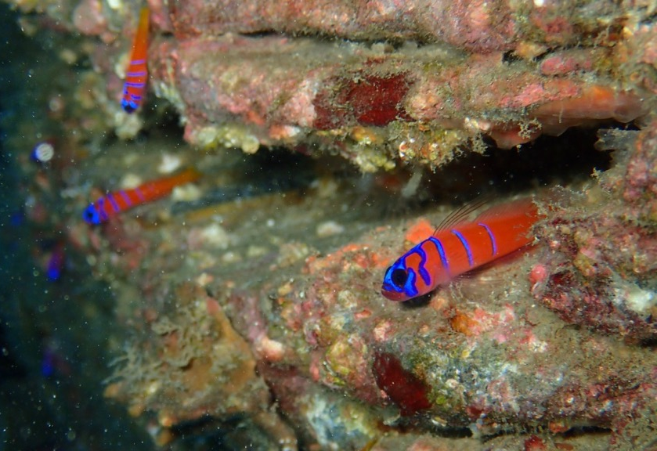
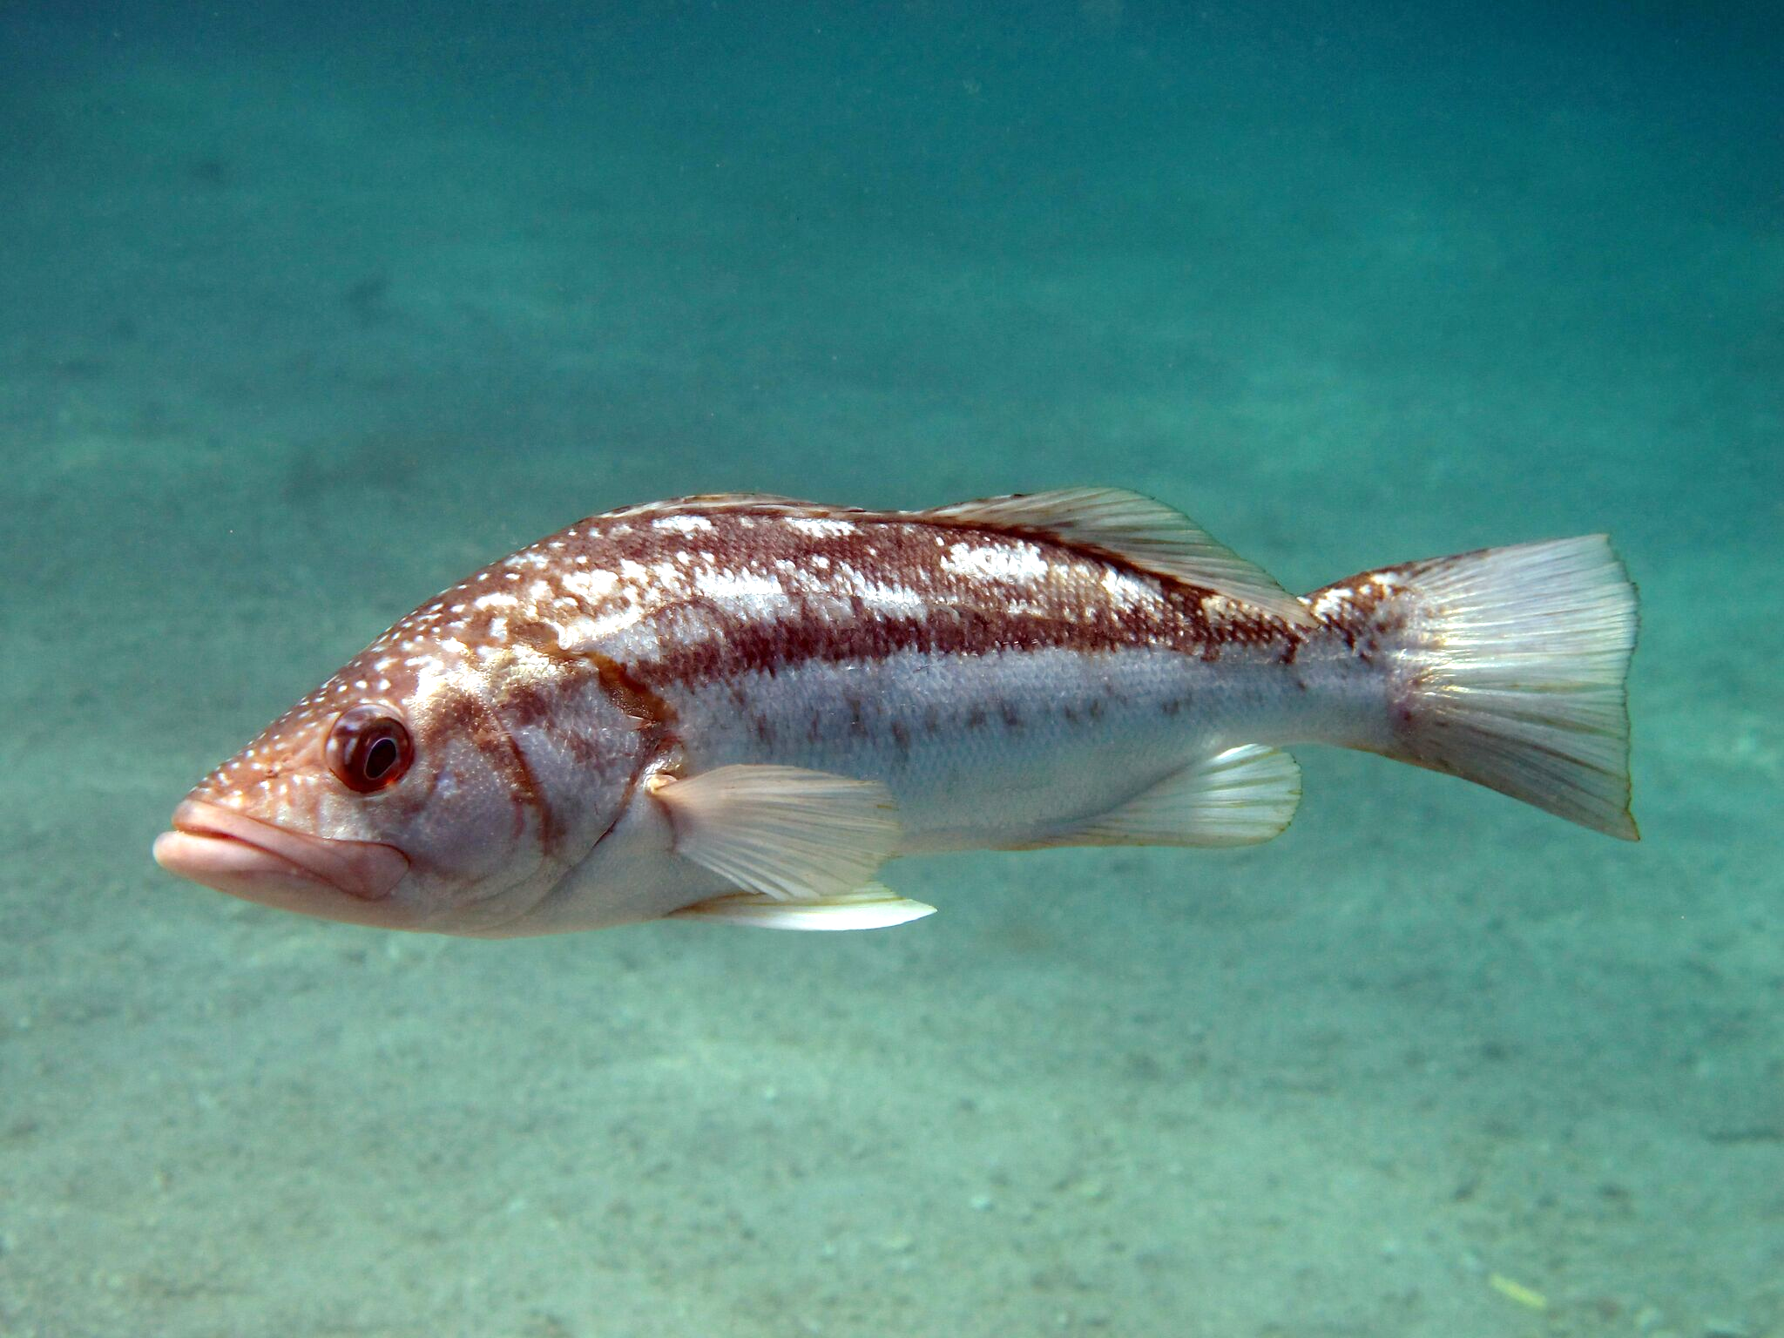
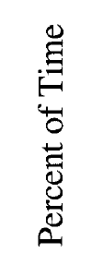
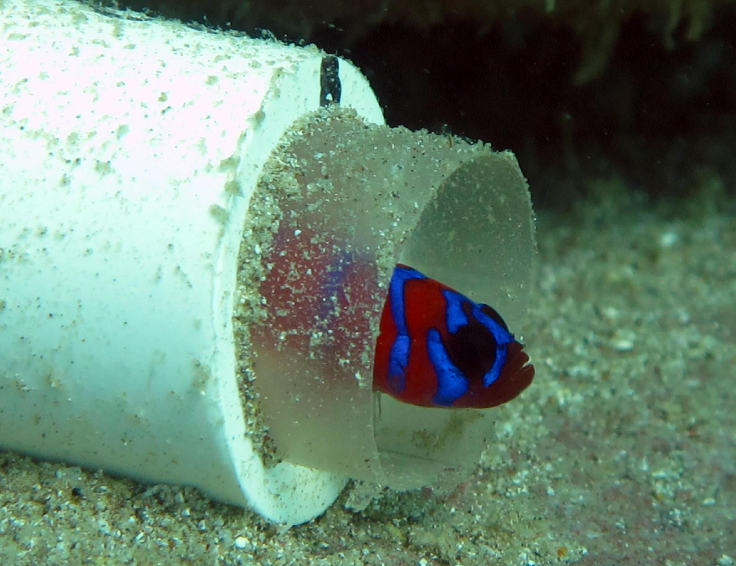
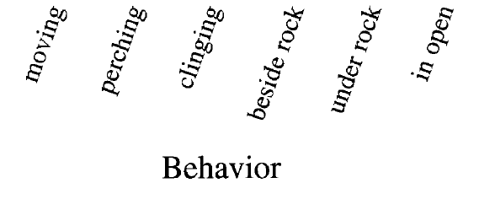
Bluebanded goby (Lythrypnus dalli)
___
1 cm
Brood-spawning fish
Alters behavior when threatened by predators
How does increased risk from predators affect reproduction of bluebanded gobies?
Scott Hamilton
Steele 1998
Scott Hamilton
Griffin Srednick
Scott Hamilton
Steele 1998
Notes:
Highly abundant reef-fish, Eastern pacific, Central California to Peru
been used in a number of demographic studies in fishes
Stay in one place, relatively easy to transplant for manipulative experiments
Live to be 2 years old, reproduce for 8 months during their life
Good for running replicate studies in a single field season
Low reproductive plasticity → less likely to suppress reproduction?
(photo) typically how you see BBG, perching is important for foraging, vigilance to predators, and mating
High parental investment → females lay eggs, males fertilize and guard (nest photo)
Will spawn in artificial nests → allows me to directly measure reproductive output with egg counts
Responds to predation risk in field → kelp bass is predator of adult gobies
lower foraging and more time hiding
Will likely affect energy acquisition and coursthip

Slide 5
Expected effects of increased predation risk on bluebanded gobies
Reproduction
Fewer eggs produced
Behavior
Increased hiding
Lower foraging and courtship
Higher mortality
Notes:
Based on previous work with this species, chose to look at three responses that would likely be affected by predation risk in bluebanded gobies
Just state
Just state
Based on previous work in this species (on effects of predators on BBG), and their highly social mating tendencies, I think that predator avoidance behaviors will severely affect foraging and courtship behaviors, leading to reductions in reproduction and survivorship
T: To try and simulate a more natural response of gobies to predators, I conducted a caging experiment in the field

Slide 6
1.5 m
Notes:
First I constructed a series of rocky reefs, standardized by the amount of rocks and number of artificial nests (shown as white cylinders) on each
Covered with one of three caging types to manipulate predator access to prey and perceived risk by gobies. Idea being, larger separation between predators and prey = less risky

Slide 7

Low risk
Medium risk
High risk
Low sublethal +
no lethal effects
High sublethal +
no lethal effects
High sublethal +
lethal effects
1.5 m
0.75 m
0.75 m
20 gobies per reef: 5 males + 15 females (5 gravid)
Notes:
Low risk treatment, reefs were covered with large cages that excluded predators at a far distance
Blue shading represents mesh that excluded predators, but was large enough for gobies to swim through (although reefs were separated from each other to limit emigration)
Observations suggest that predators excluded beyond this distance (~0.5m) do not induce changes in goby behavior
Med risk – same concept as low, excluded predators, but smaller cage allowed predators to get closer to prey
High risk, removed side panels of mesh to allow for full predator access
c. Populations were based off of natural size and sex ratios at the start of each trial
Key point: goal here was to keep all reefs and initial populations equal, except for the level of predator access

Slide 8
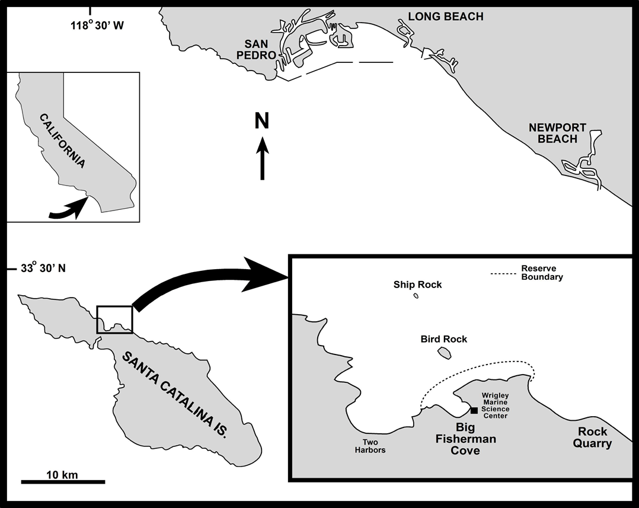
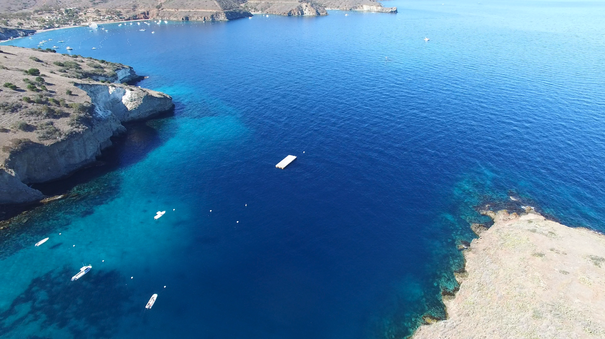
BEM!
18 reefs
6 low, 6 medium, 6 high
Catalina Island
500 km
Larry Allen
Chris Lowe
500 km
Chris Lowe
Notes:
Ran experiment 2 times in the summer of 2018

Slide 9
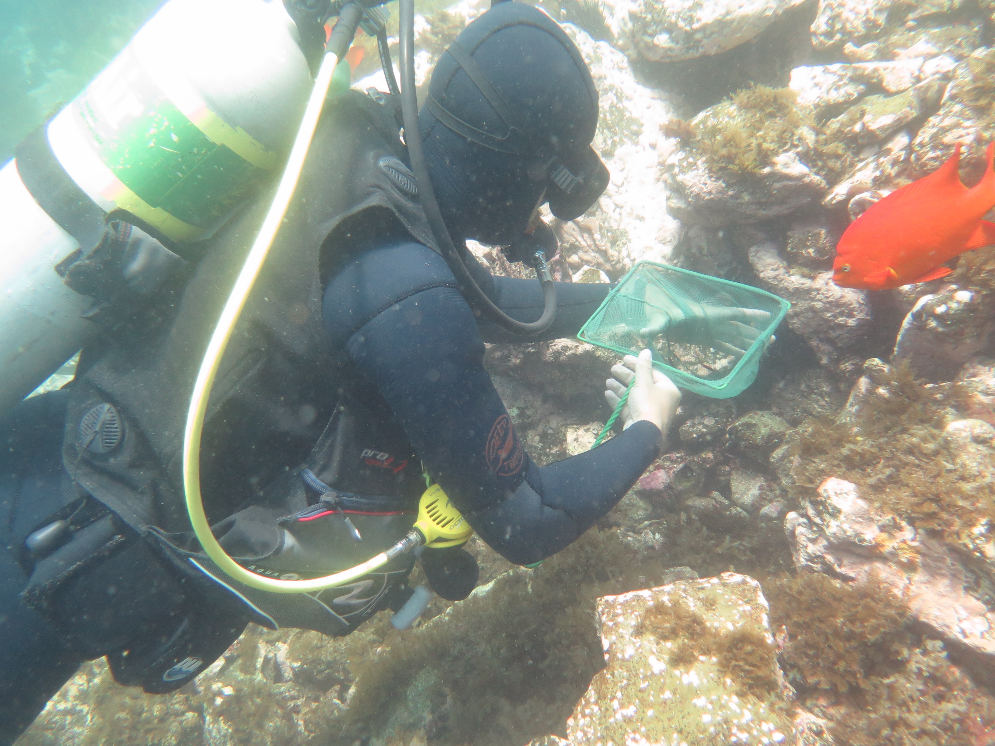
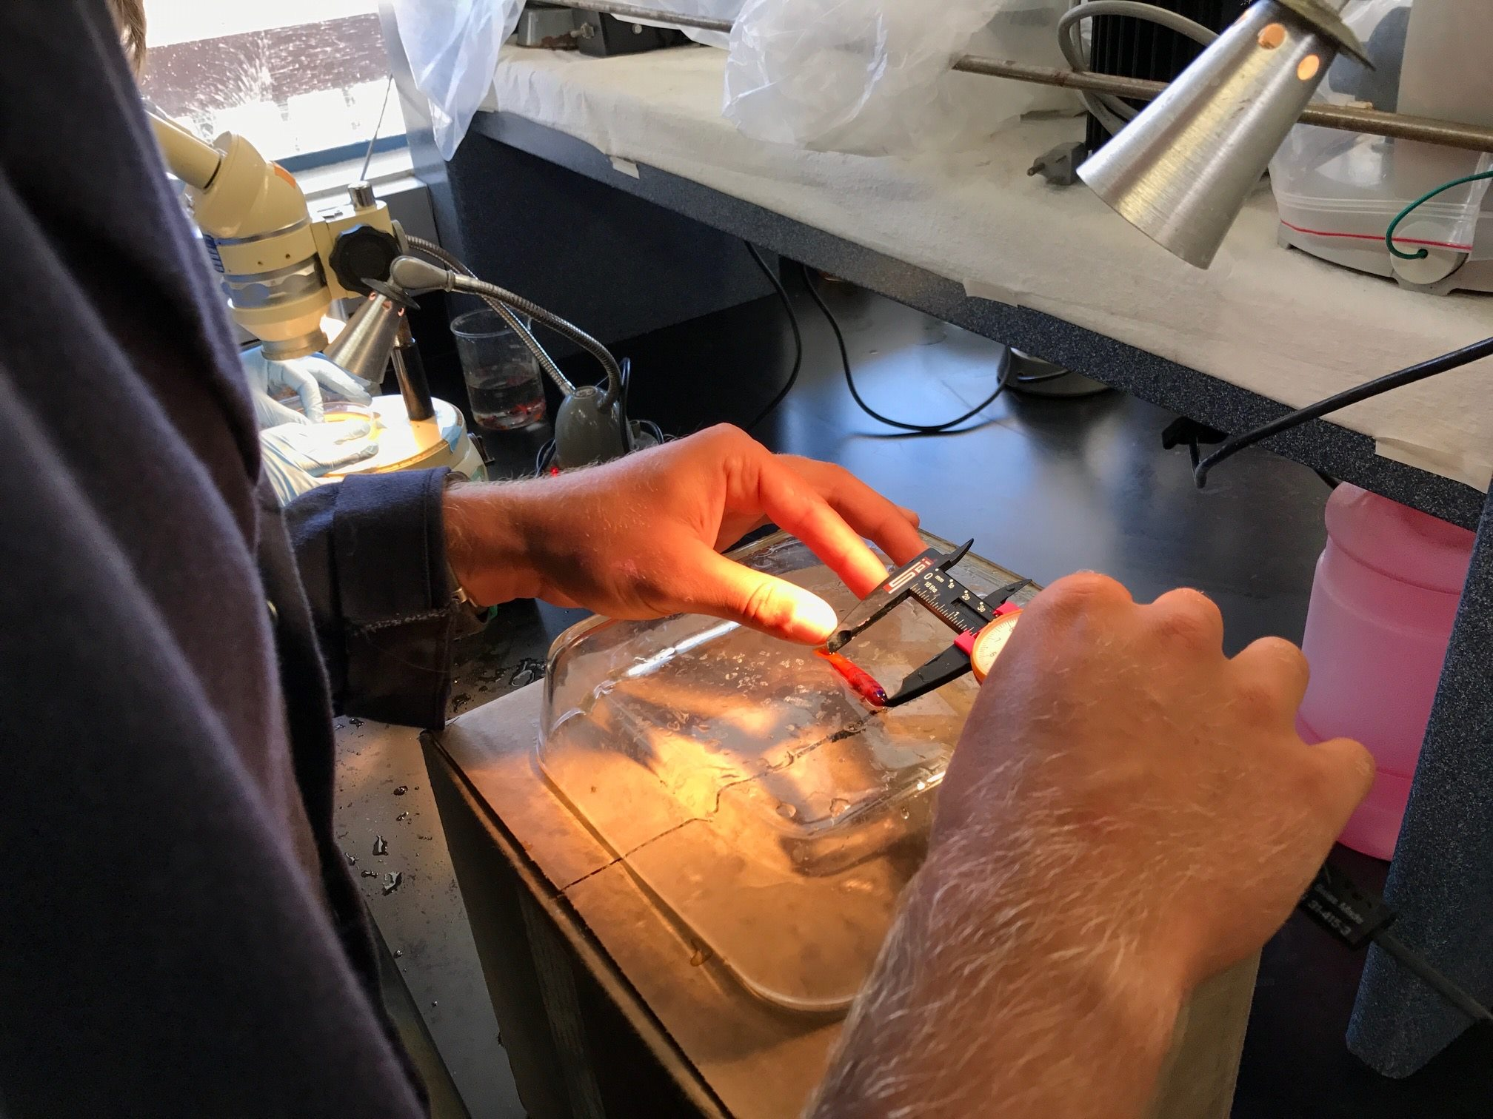
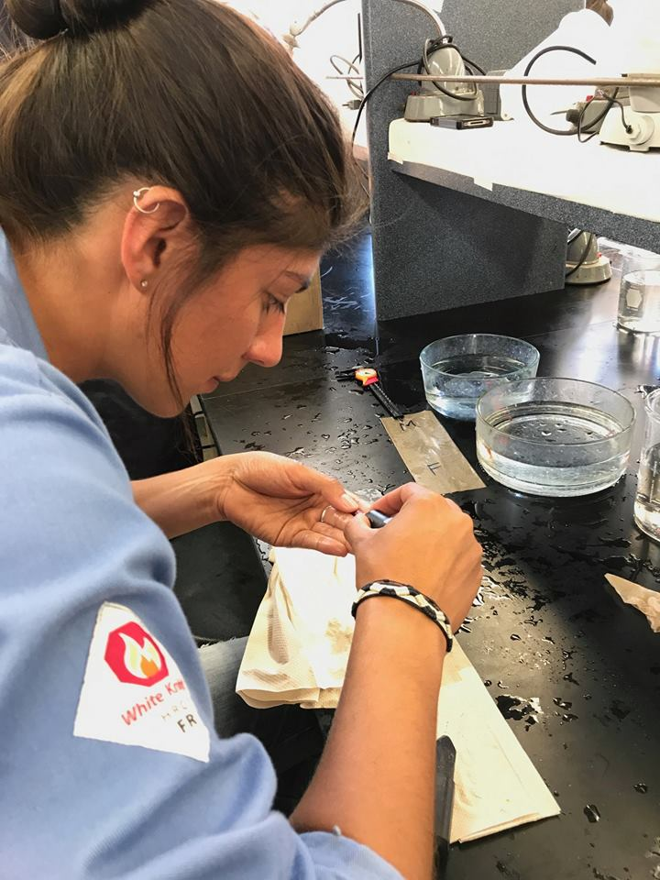
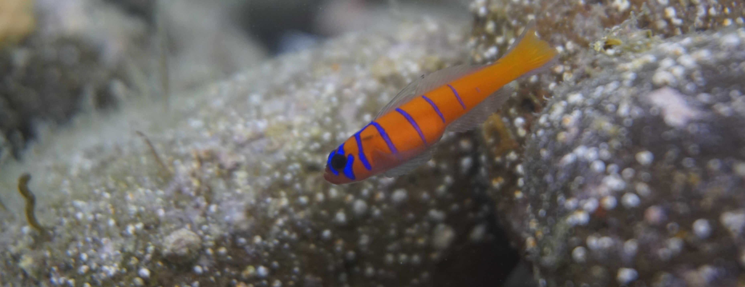
Fish collections and tagging
Initial size: 30 mm
Hunter Ramo
Erika Nava
Mia Adreani
Mia Adreani

Slide 10
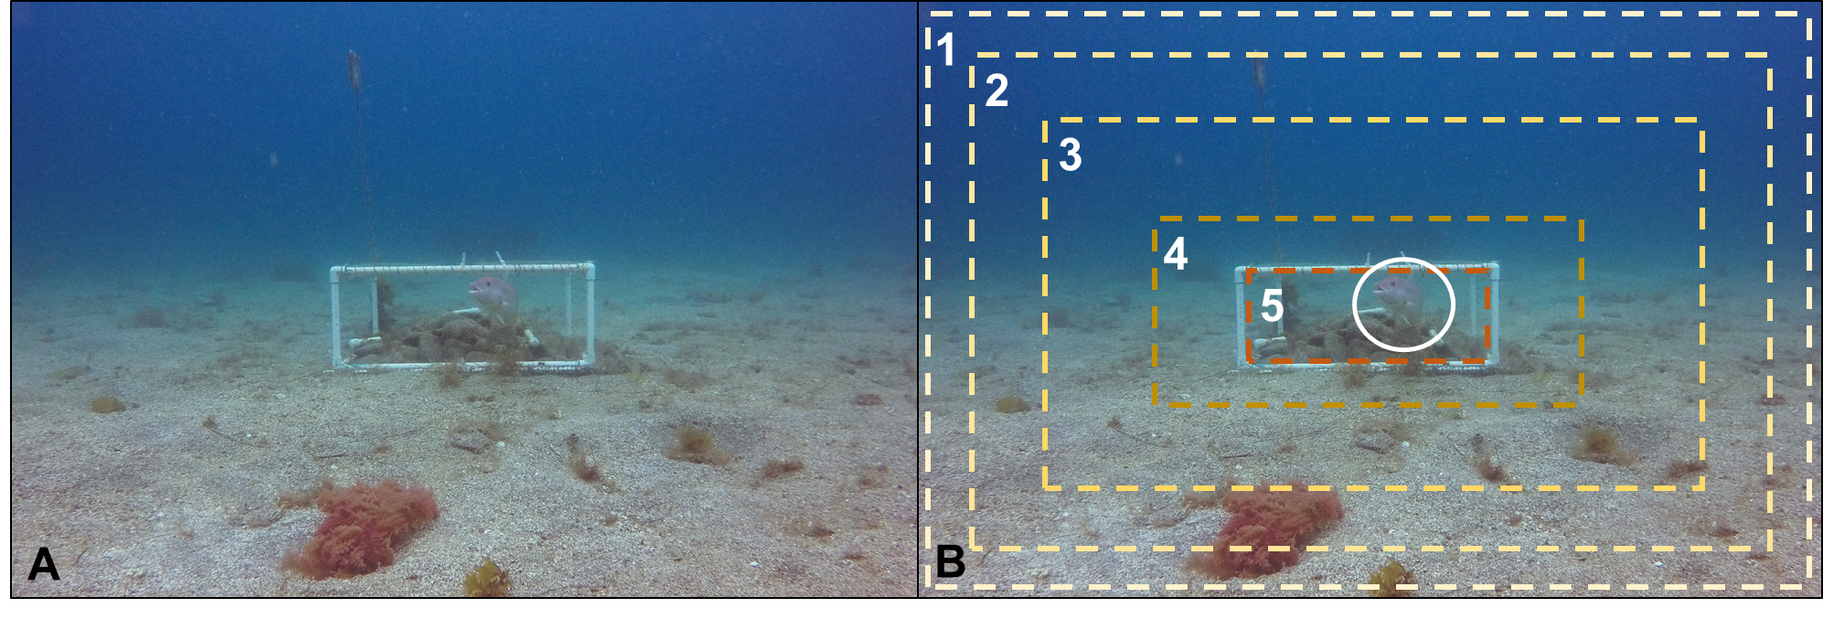
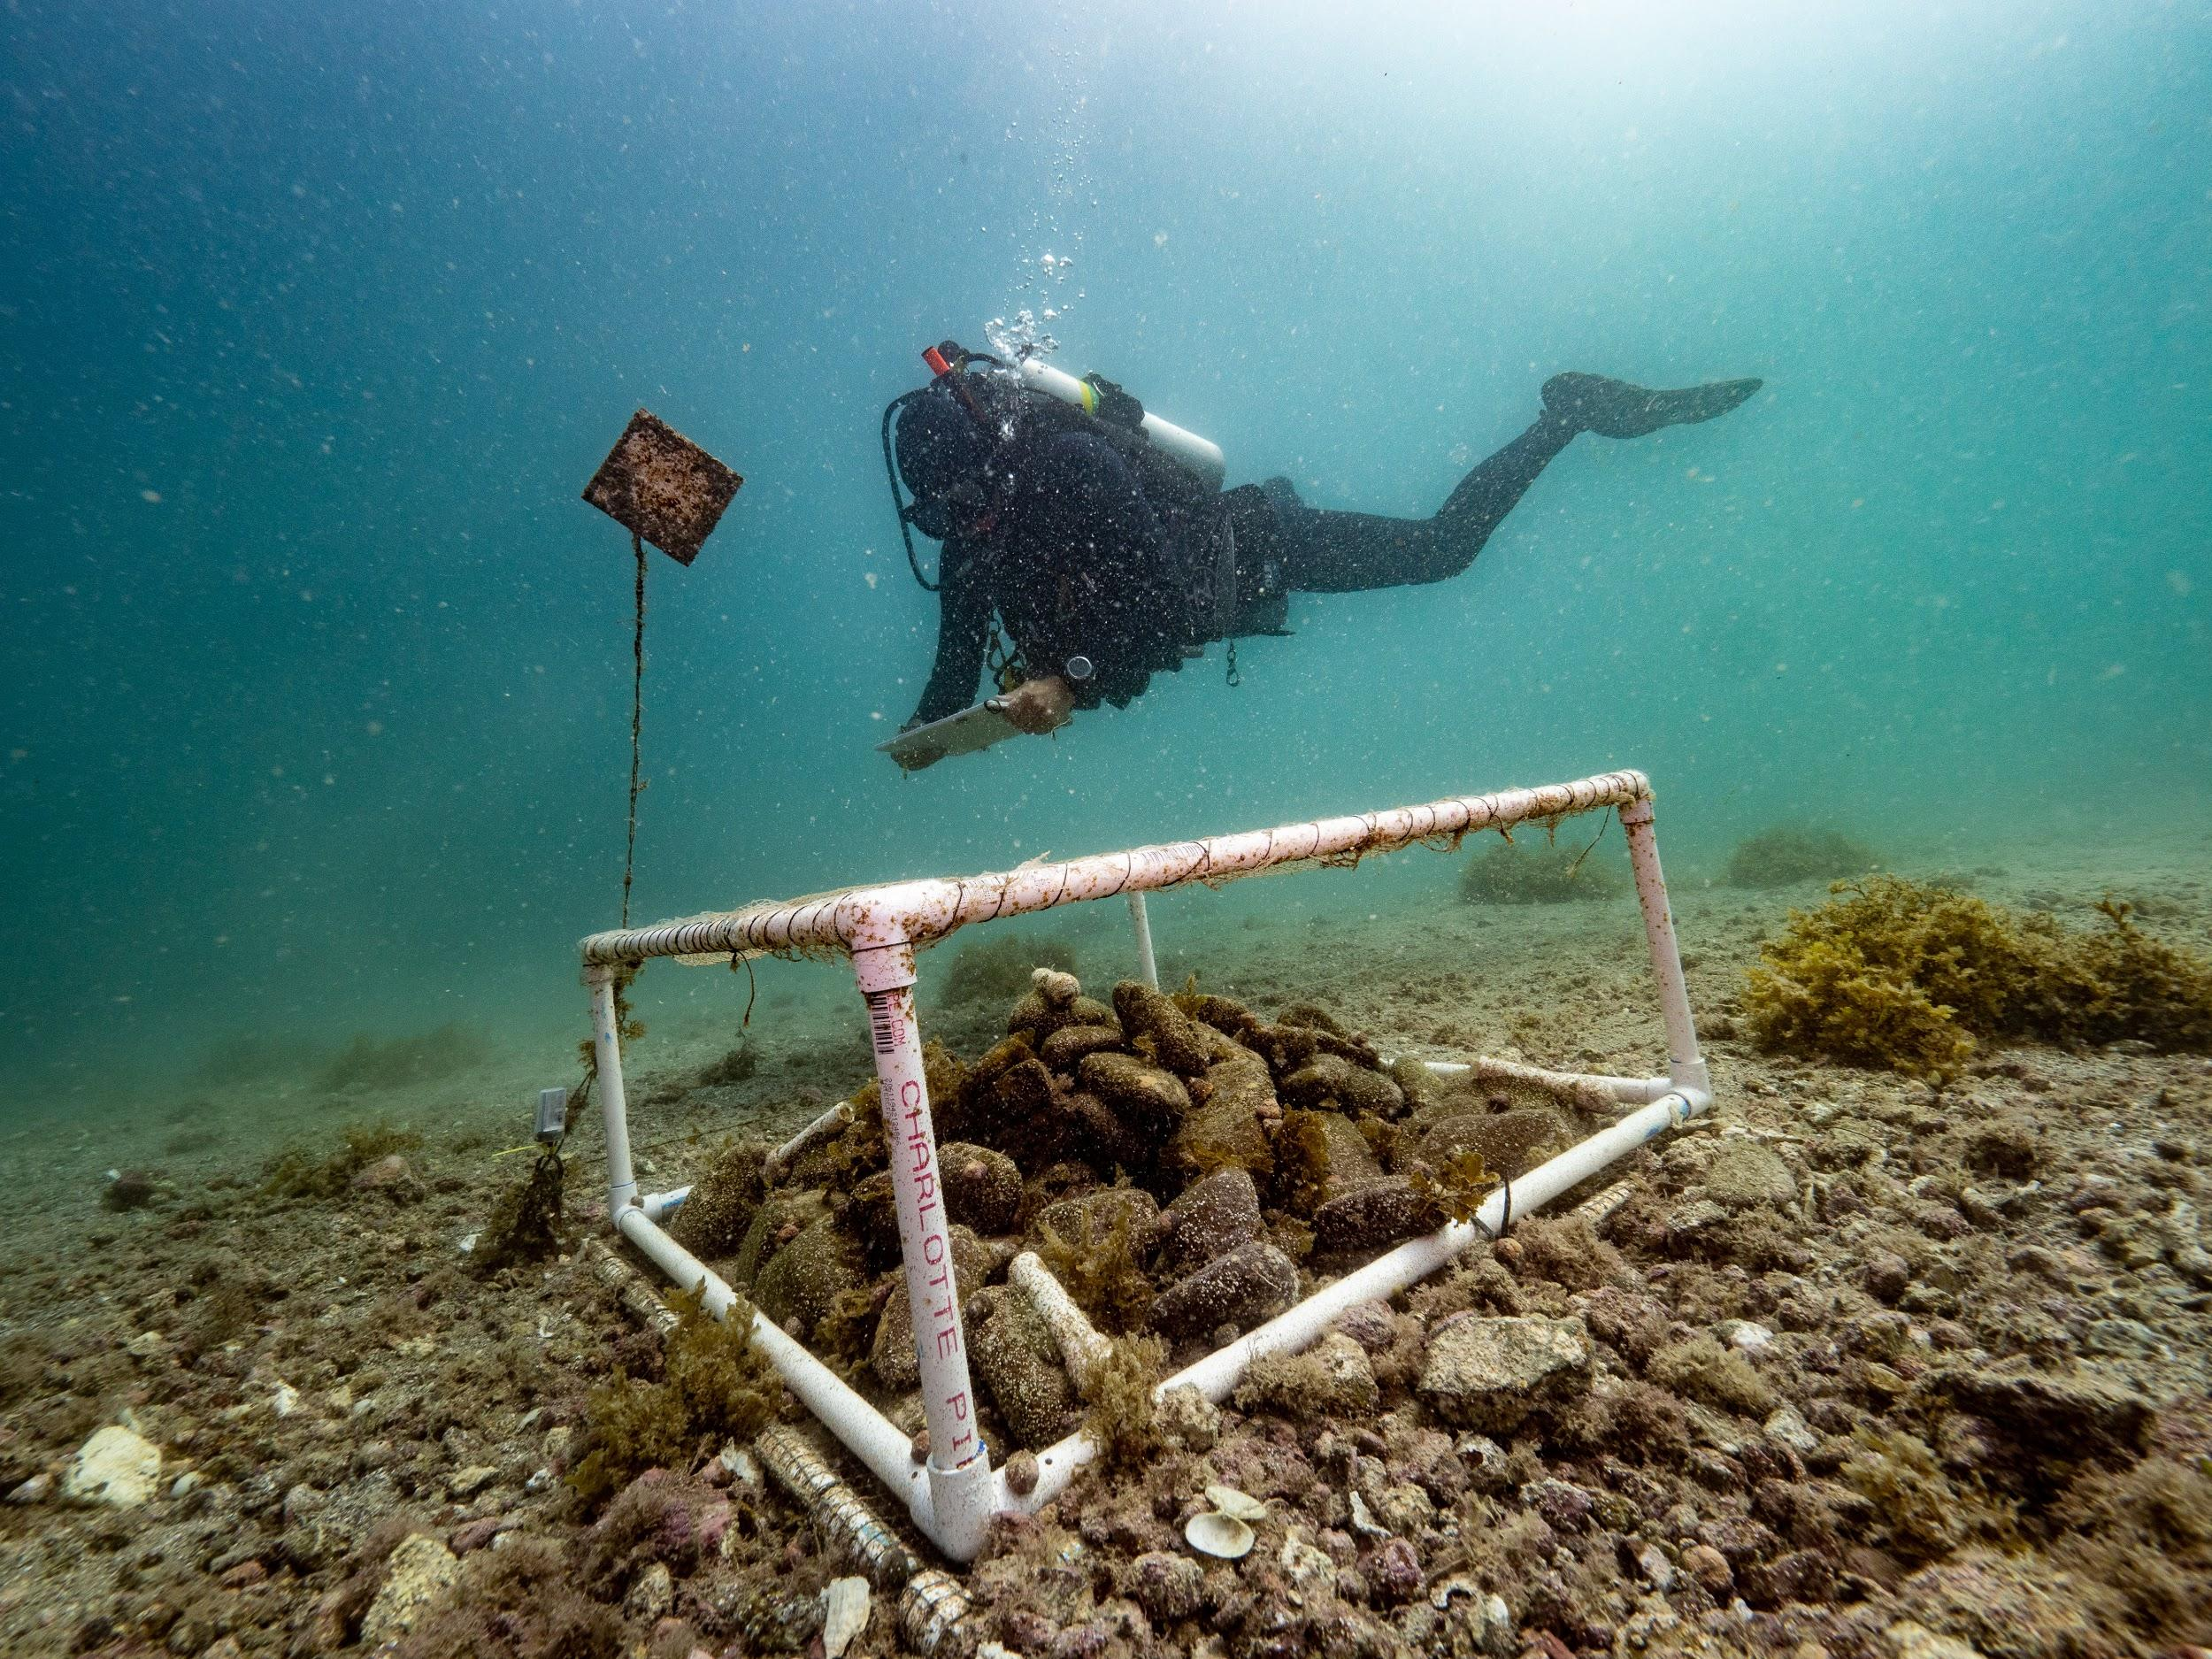
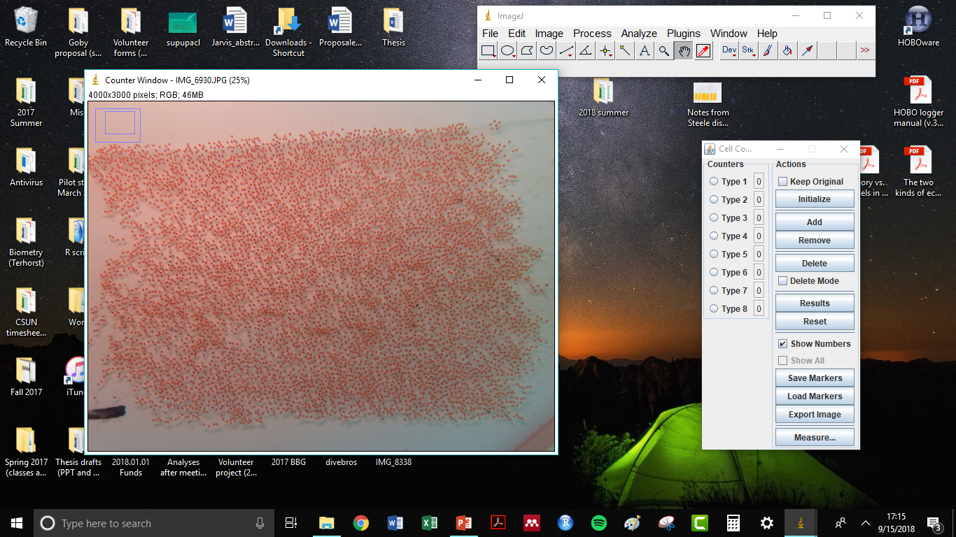
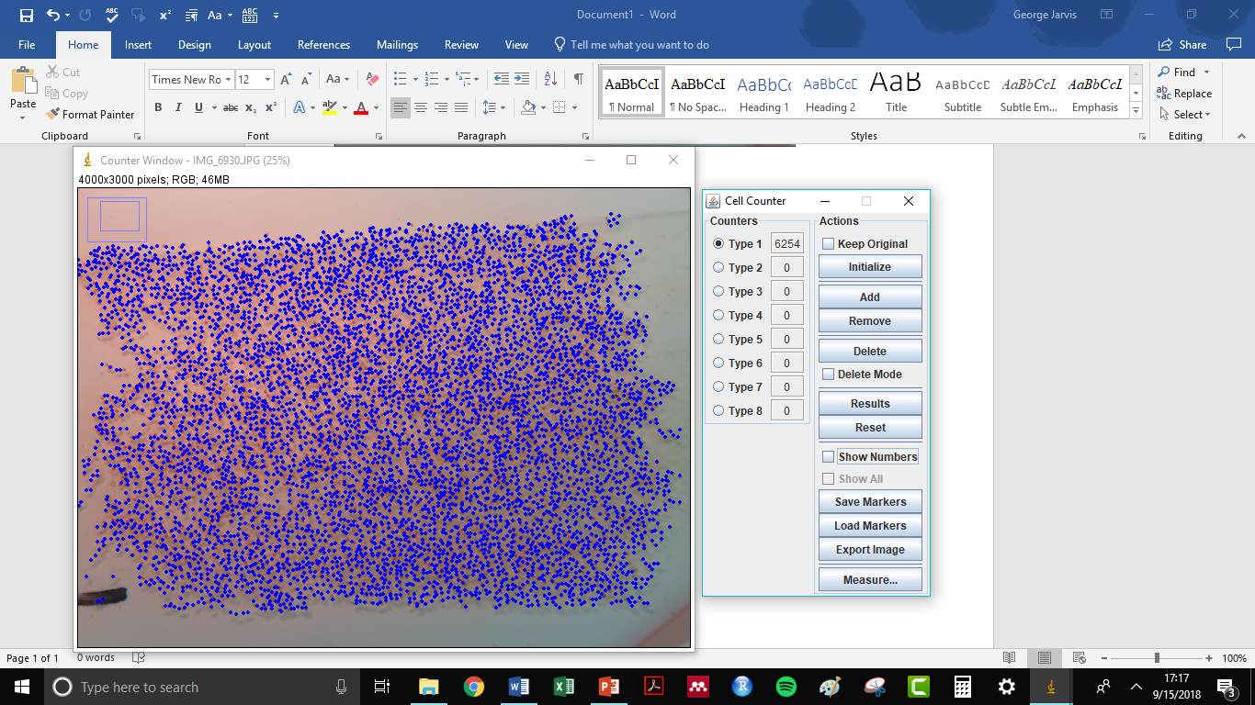
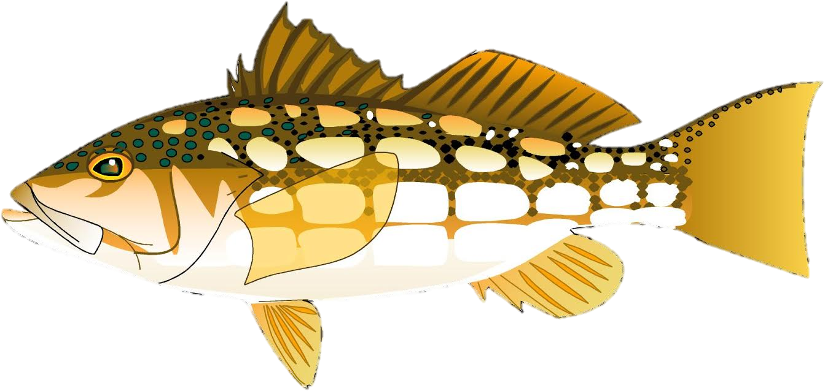
Reef surveys
Reproduction
Egg counts
Behavior
Exposure time, foraging, courtship
Recollections
Visual counts
Predator activity
Level of perceived risk
Likely perceived as low threat
Not likely perceived as threat
Likely perceived as high threat
Maurice Roper
Casey Benkwitt
Scott Hamilton
Notes:
Explain what you did for each, and then these points for why you did them
To test for differences in egg production among treatments
(visual counts) To monitor survivorship during trial, and (recollections) to see how risk affected mortality among treatments (i.e., lethal removals in high-risk reefs)
Monitored individual gobies to see how fitness behaviors may have been affected by risk
I observed gobies from the same relative distance to the reef among treatments
Foraging, courtship, number of moves
As a measure of hiding
I believe that these behaviors will be reduced in risky environments, and will help me understand the mechanism for any differences in fitness among treatments

Slide 11
Experiment | Year | Trials | Duration | Initial sex? | Treatments
1 | 2017 | 3 | 1 week | Yes | 3
2 | 2018 | 2 | 1 month | No | 3
3 | 2018 | 1 | 2 weeks | No | 4

Slide 12
Statistical Analyses
Response Variables | Analysis | Explanatory Variables
Reproductive output | ANCOVA | Fixed: risk treatment Covariate: number of gobies recollected
Recollections | ANOVA | Fixed: risk treatment
Visual counts | ANOVA | Fixed: risk treatment, time
Fitness behaviors (Exps. 1 and 2) | MANOVA | Fixed: risk treatment
Predator activity: Abundance Perceived as low risk Perceived as high risk | PERMANOVA x 3 | Fixed: risk treatment
Notes:
Ran these separately for each of my experiments

Slide 13
Experiment | Year | Trials | Duration | Initial sex? | Treatments
1 | 2017 | 3 | 1 week | Yes | 3
2 | 2018 | 2 | 1 month | No | 3
3 | 2018 | 1 | 2 weeks | No | 4

Slide 14
Experiment | Year | Trials | Duration | Initial sex? | Treatments
1 | 2017 | 3 | 1 week | Yes | 3
2 | 2018 | 2 | 1 month | No | 3
3 | 2018 | 1 | 2 weeks | No | 4

Slide 15
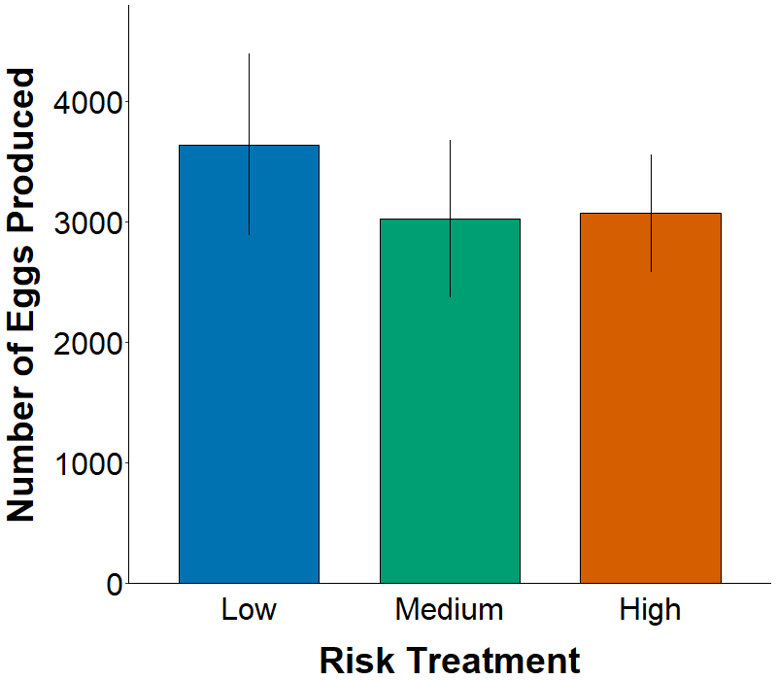
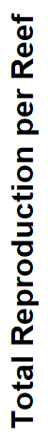
Similar reproduction among risk treatments
ANCOVA
Treatment: P = 0.73
Recollection: P = 0.015
Treatment × recollection: P = 0.48
n = 18

Slide 16
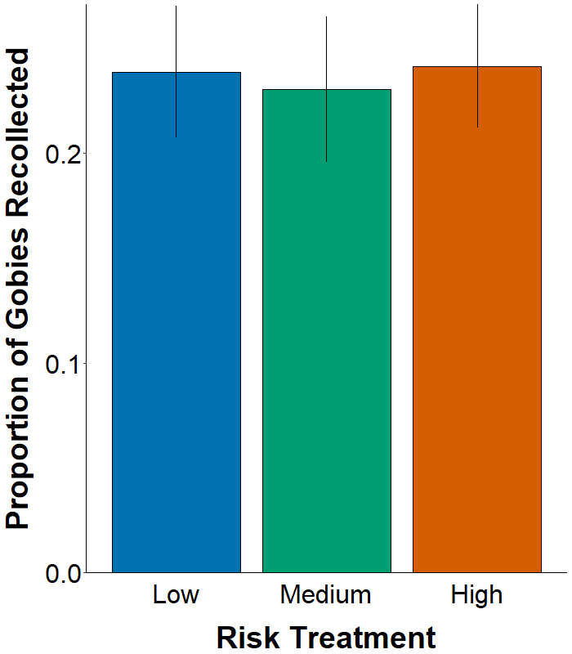
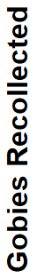
No measurable effect of risk on recollections
ANOVA
Treatment: P = 0.97
Suggests no lethal predation on high-risk reefs
Notes:
No legend needed, can code that out in ggplot
Recollected the same proportion of gobies from each of the three risk treatments, showing the lethal effects of predation were not likely affecting the lower counts in high-risk.

Slide 17
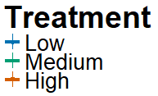
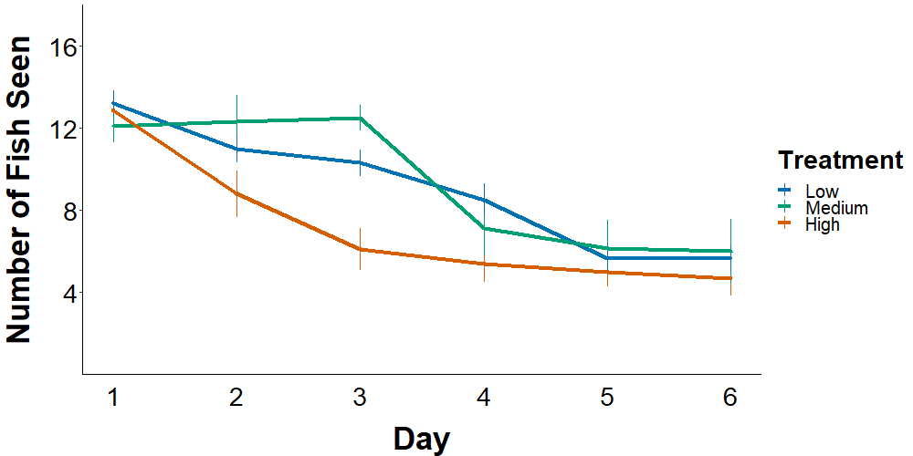
Fewer gobies observed on high-risk reefs
Poisson GLM
Treatment: P < 0.039
Time: P < 0.0001
Treatment*time: P = 0.55
Seen 19% less frequently on high-risk reefs
Notes:
Y = number of fish seen per reef
X = week of the survey
The number of gobies seen on the reefs decreased over time, regardless of risk
However, I consistently saw fewer gobies on high-risk reefs during the experiments, 21% reduction overall
As long as predators were excluded at all (low and medium risk treatments), no changes in number of fish seen
Don’t know if the reductions in high-risk treatment were due to lethal or sublethal effects, where predators were allowed full access

Slide 18
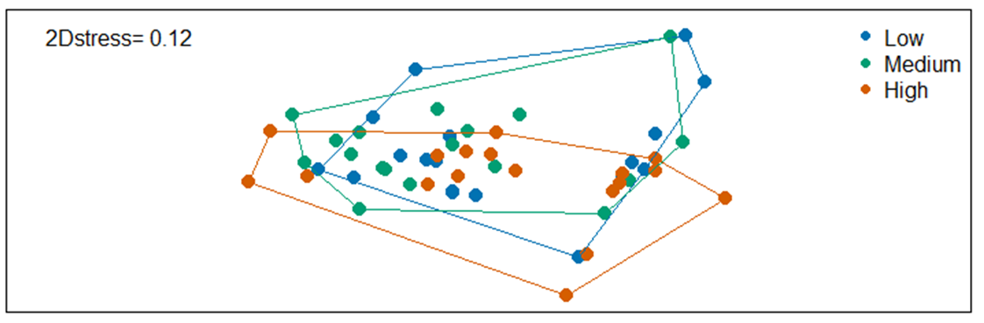
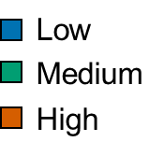
Comparable effects of risk on goby behavior
MANOVA
Treatment: P = 0.109
n = 18
1-way ANOVAs
Exposure time: P = 0.17
Movements*min⁻¹: P = 0.40
Bites*min⁻¹: P = 0.31
Courtship*min⁻¹: P = 0.18
Distance moved: 0.73
nMDS 2
2D Stress = 0.12
nMDS 1

Slide 19
Exp 1: Observed effects of predation risk on bluebanded gobies
Reproduction
No measurable effect on egg production
Behavior
More time hiding
Similar effects on courtship, foraging, and survival
Notes:
Really only affected

Slide 20
Experiment | Year | Trials | Duration | Initial sex? | Treatments
1 | 2017 | 3 | 1 week | Yes | 3
2 | 2018 | 2 | 1 month | No | 3
3 | 2018 | 1 | 2 weeks | No | 4

Slide 21
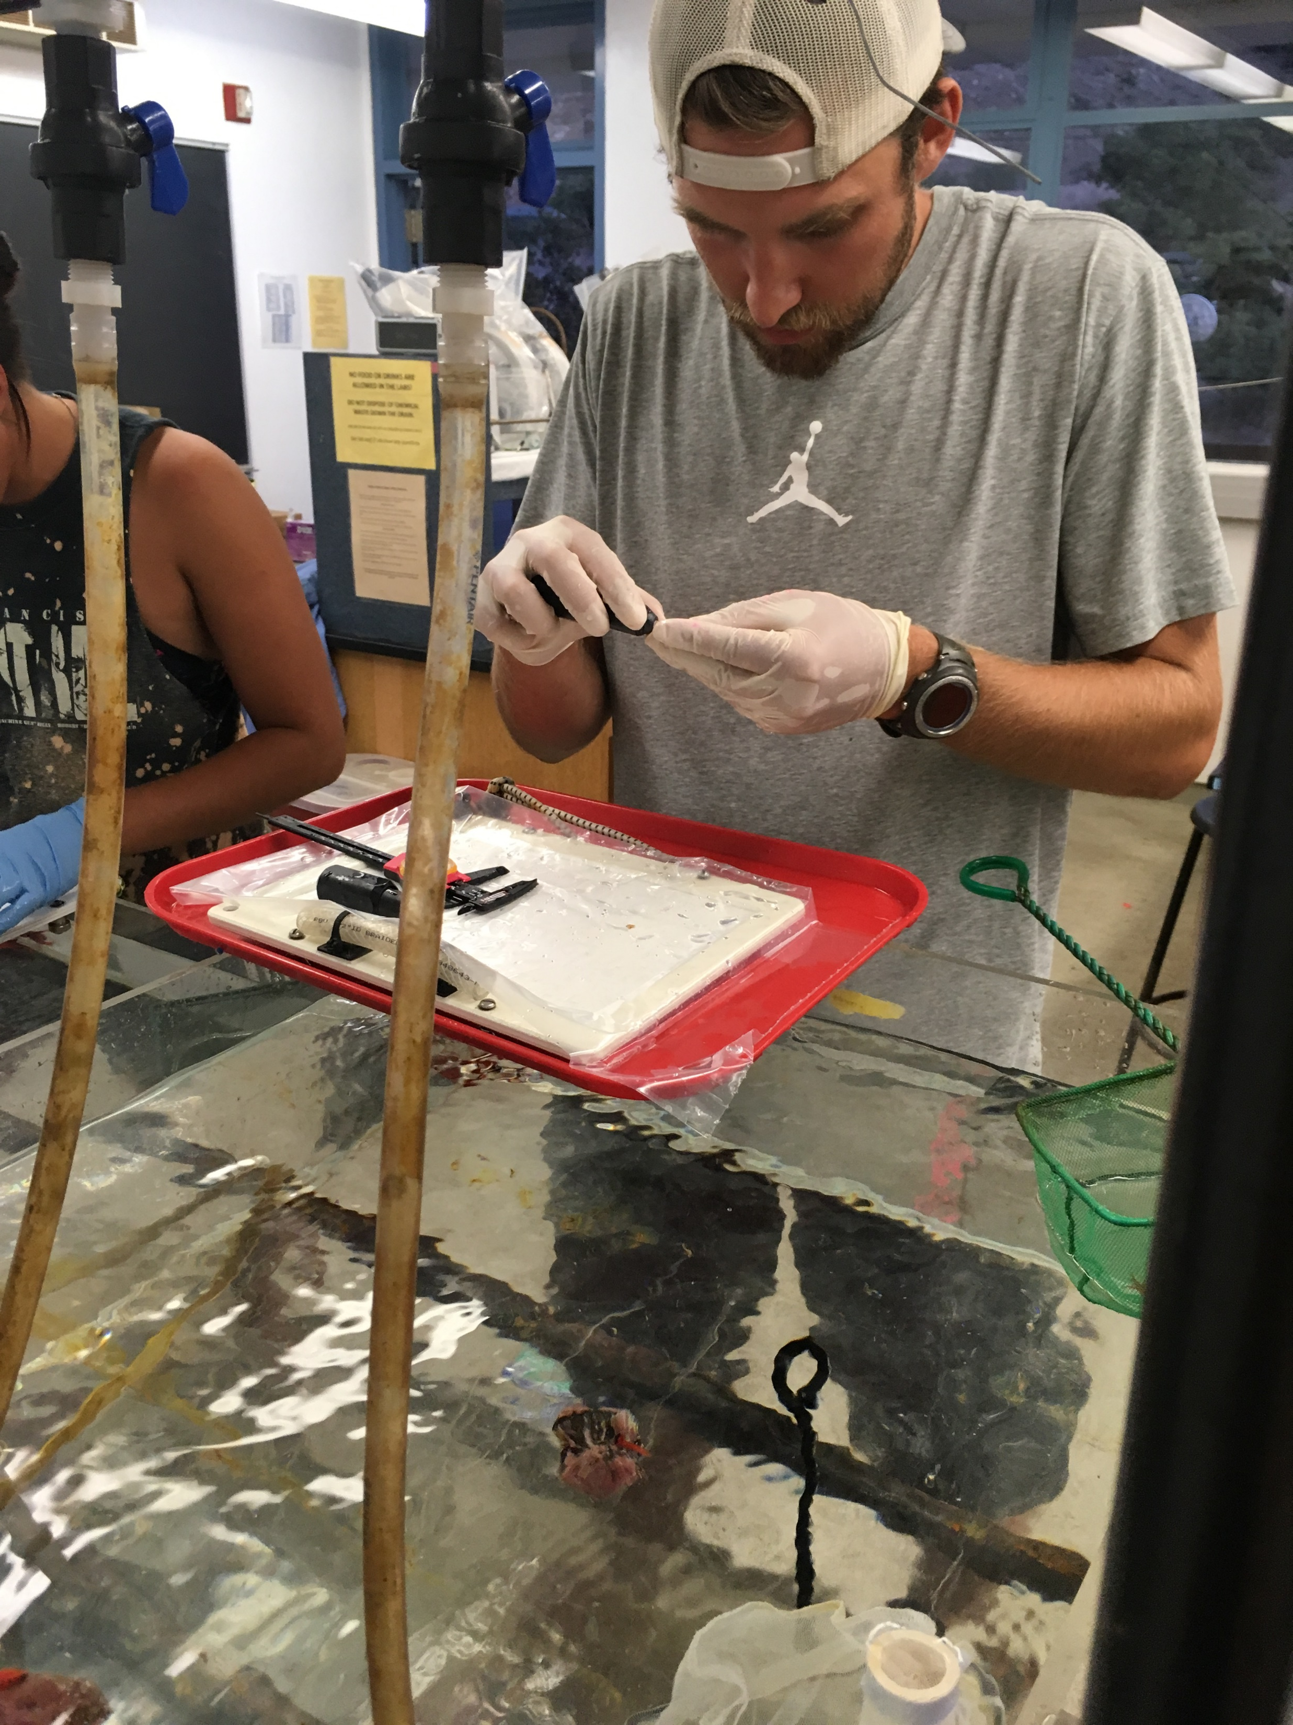
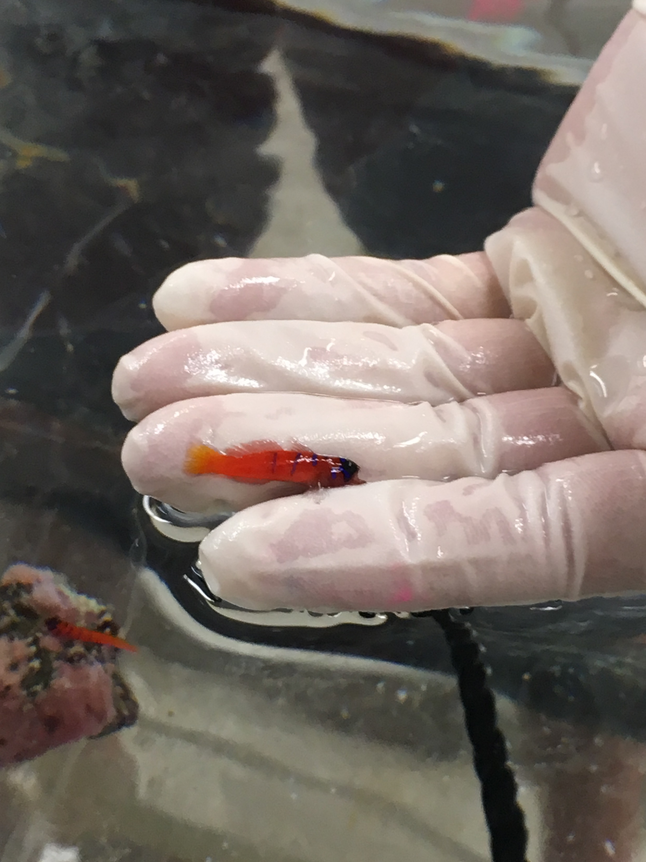
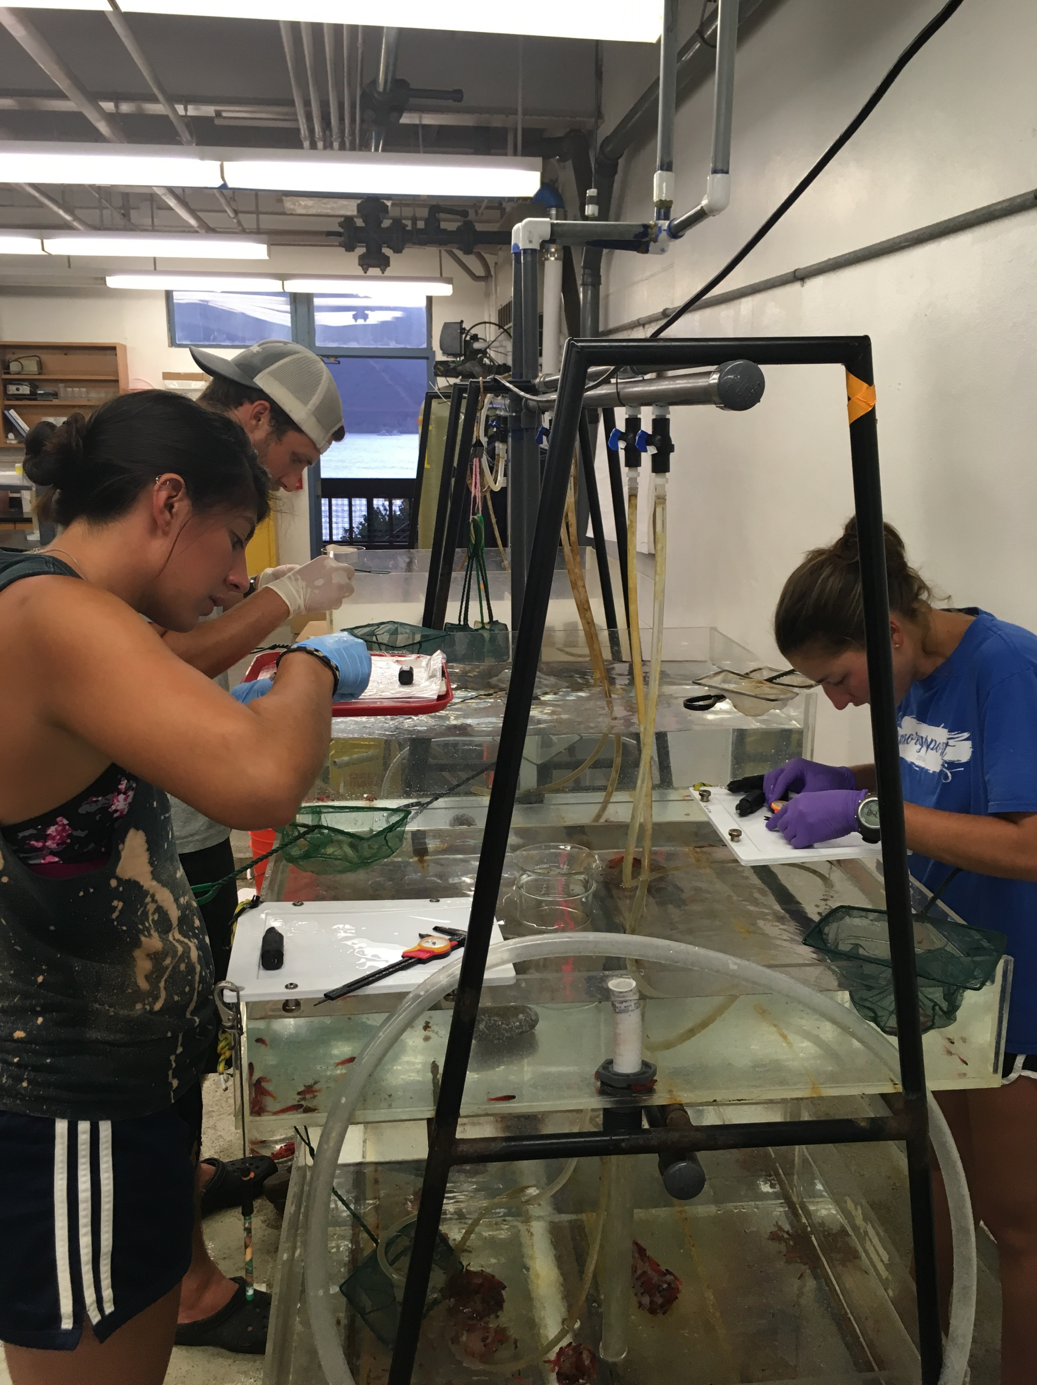
Notes:
Mention now that we stocked the reefs based on similar initial sizes that reflected the size structure naturally

Slide 22
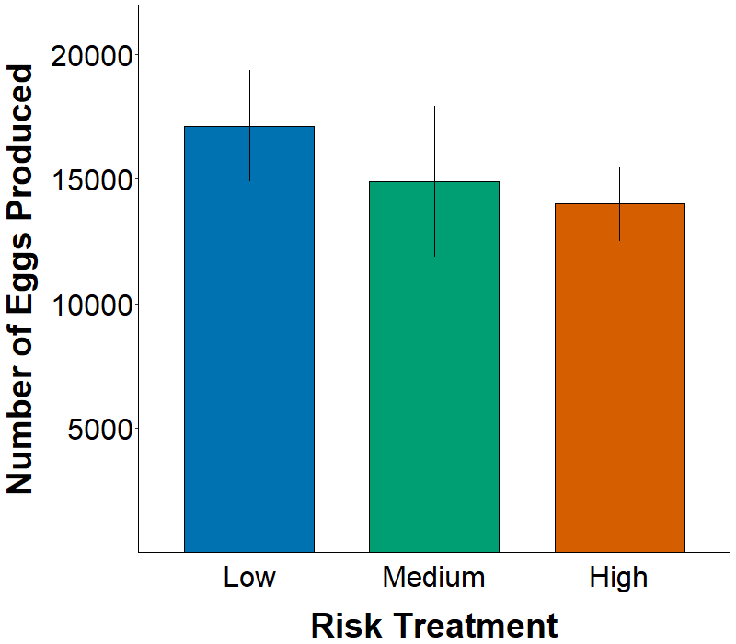
Similar reproduction among risk treatments
ANCOVA
Treatment: P = 0.19
Recollection: P < 0.0001
Treatment × recollection: P = 0.20
n = 12
Notes:
Y = total egg production per reef after 1 month
X = risk treatment
Showing means and standard errors in figure
No legend needed, but mention that colors will be consistent throughout talk
Might not be statistical differences in output, but we see a trend of decreasing production with decreasing distance between predators and prey
Based on these results, might not expect to see differences in other responses. Let’s check out the surveys for mortality, first visual surveys, where I swam over each reef and counted the number of fish visible on each

Slide 23
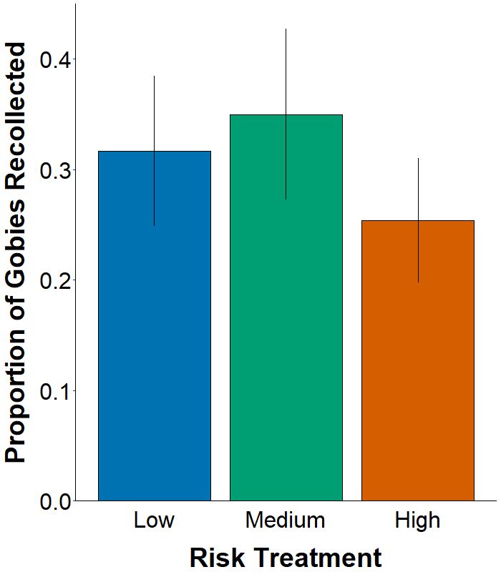
No measurable effect of risk on recollections
ANOVA
Treatment: P = 0.60
Supports no lethal predation on high-risk reefs
Notes:
No legend needed, can code that out in ggplot
Recollected the same proportion of gobies from each of the three risk treatments, showing the lethal effects of predation were not likely affecting the lower counts in high-risk.

Slide 24
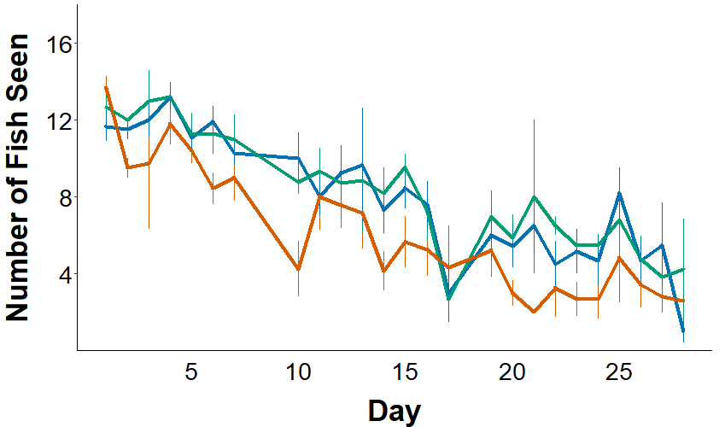
Fewer gobies observed on high-risk reefs
Poisson GLM:
Treatment: P < 0.0001
Time: P < 0.0001
Treatment*time: P = 0.63
Seen 21% less frequently on high-risk reefs
Notes:
Y = number of fish seen per reef
X = week of the survey
The number of gobies seen on the reefs decreased over time, regardless of risk
However, I consistently saw fewer gobies on high-risk reefs during the experiments, 21% reduction overall
As long as predators were excluded at all (low and medium risk treatments), no changes in number of fish seen
Don’t know if the reductions in high-risk treatment were due to lethal or sublethal effects, where predators were allowed full access

Slide 25
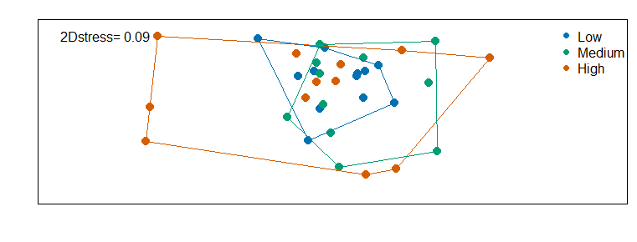
Observed behaviors varied by treatment
MANOVA
Treatment: P = 0.018
n (Low, Med, High) = 11, 11, 12
1-way ANOVAs
Exposure time: P = 0.009
Movements*min⁻¹: P = 0.086
Bites*min⁻¹: P = 0.48
Courtship*min⁻¹: P = 0.91
Distance moved: 0.19
nMDS 2
2D Stress = 0.09
Gobies seen 18% less frequently on high-risk reefs
nMDS 1
Notes:
Univariate ANOVAs are consistent with results from visual counts

Slide 26
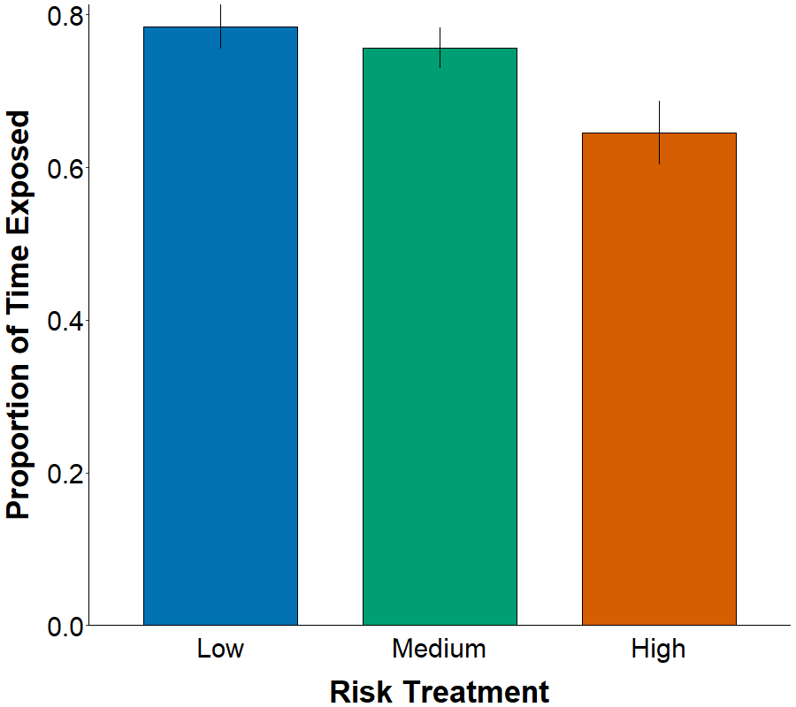
Less time exposed on high-risk reefs
ANOVA
Treatment: p = 0.007
*
Notes:
16% reduction in time exposed on reefs, which remember, is important for fitness behaviors in bluebanded gobies

Slide 27
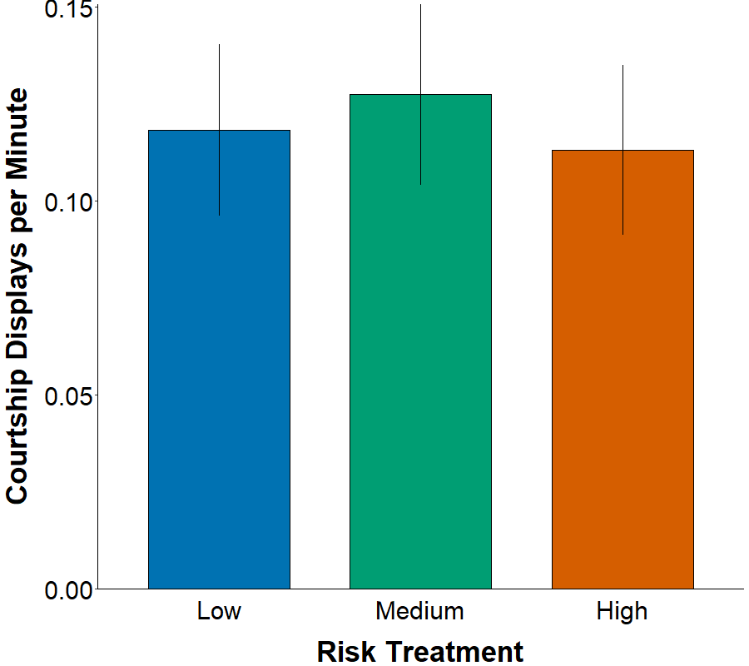
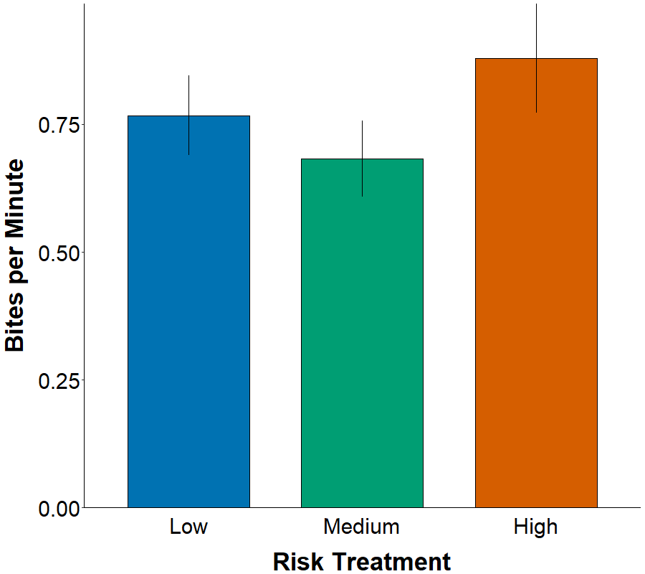
Similar courtship and foraging among treatments
P = 0.91
P = 0.48
Notes:
Results show that when courtship occurred, it was not sig. diff. among treatments

Slide 28
Exp 2: Observed effects of predation risk on bluebanded gobies
Reproduction
No measurable effect on egg production
Behavior
Overall behavioral differences
More time hidden
Similar effects on courtship, foraging, and survival
Notes:
Really only affected

Slide 29
Experiment | Year | Trials | Duration | Initial sex? | Treatments
1 | 2017 | 3 | 1 week | Yes | 3
2 | 2018 | 2 | 1 month | No | 3
3 | 2018 | 1 | 2 weeks | No | 4
Notes:
Added 2 additional reefs to the array (20 total) and ran the same experiment for 2 weeks to test for cage artifacts
Bluebanded gobies are known to respond negatively to cages (check this, might not be accurate based on Mark’s study, but I seem to remember him reporting that cages alone had a negative effect on BBGs), which is why I did not have uncaged treatments earlier, I just wanted to test this to see if there were any effects of cage

Slide 30
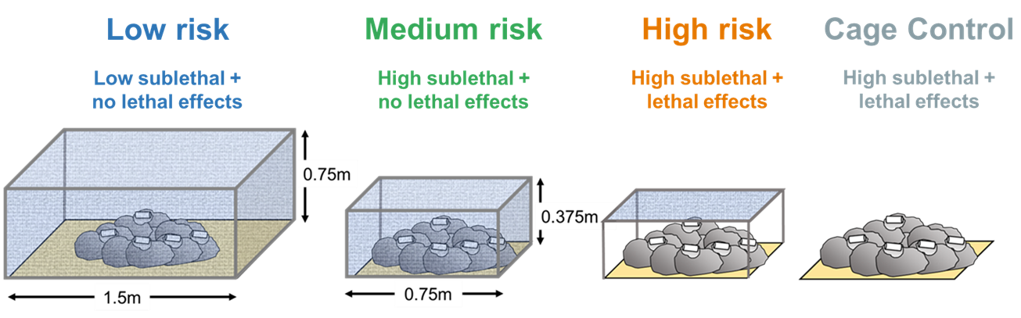
Added treatment to test for cage artifacts

Slide 31
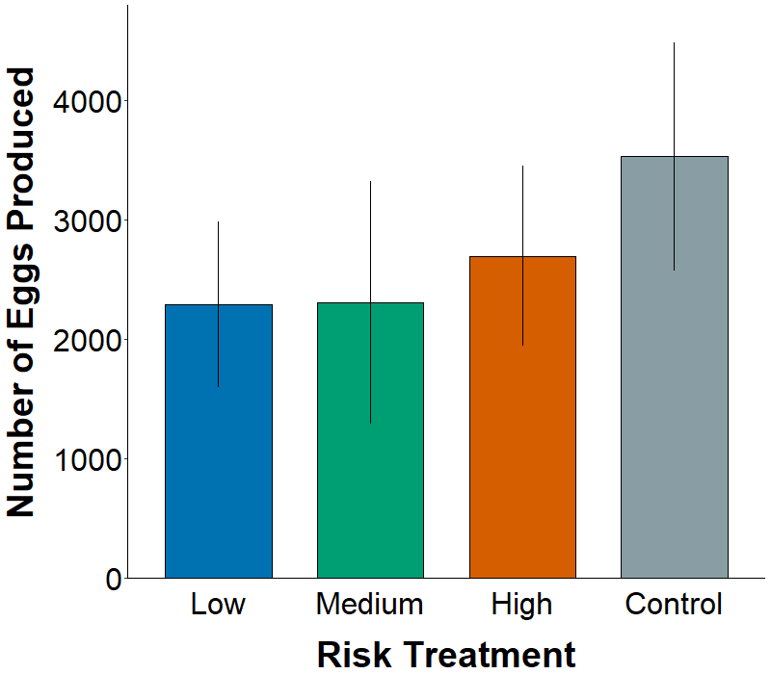
Similar reproduction among risk treatments
ANCOVA
Treatment: P = 0.76
Recollection: P = 0.26
Treatment × recollection: P = 0.93
n = 5
Notes:
Reproduction seems to be highest on the uncaged plots, but the trends are insignificant.
May be due to low sample size with only a single trial of data.
May be due to some effect of the cage on prey
Magnitude of reproduction is slightly lower than expected, given that this was a 2-week trial. Might have been nearing the end of the breeding season in August (might not want to mention that), since I didn’t really test for differences

Slide 32
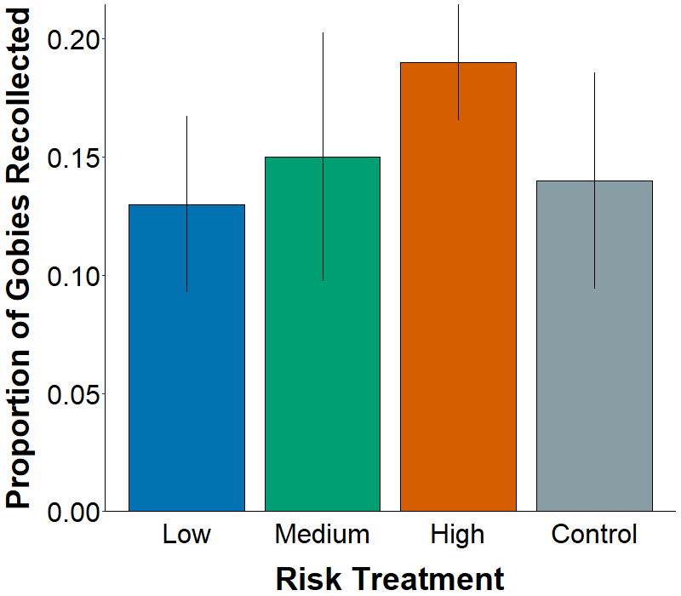
No measurable effect of risk on recollections
ANOVA,
Treatment: P = 0.75
Supports no lethal predation on high-risk reefs
Notes:
No legend needed, can code that out in ggplot
Recollected the same proportion of gobies from each of the three risk treatments, showing the lethal effects of predation were not likely affecting the lower counts in high-risk.

Slide 33
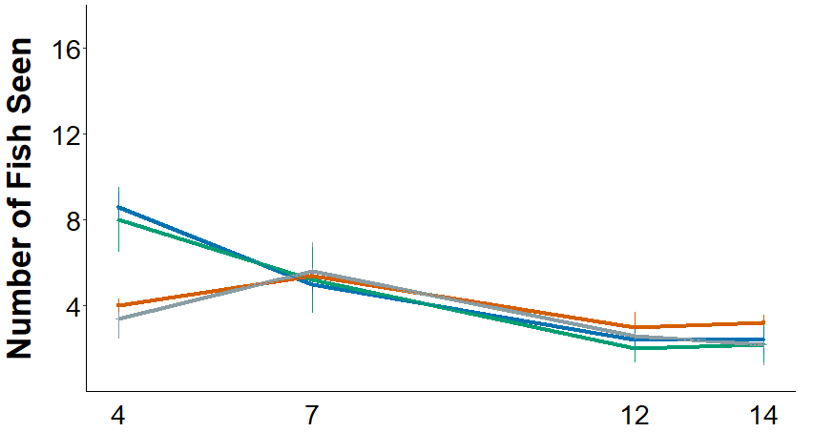
Number of gobies seen varied by risk and time
Poisson GLM:
Treatment: P = 0.29
Time: P < 0.0001
Treatment*time: P = 0.0044
Differences likely due to sampling on day 4
Notes:
Did not do behavioral analyses for Experiment 3

Slide 34
Exp 3: Observed effects of predation risk on bluebanded gobies
Reproduction
No measurable effect on egg production
Behavior
Similar effects on exposure, courtship, foraging, and survival
Results suggest minimal effect of cage in high-risk treatment
Notes:
Really only affected

Slide 35
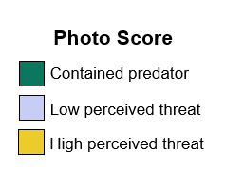
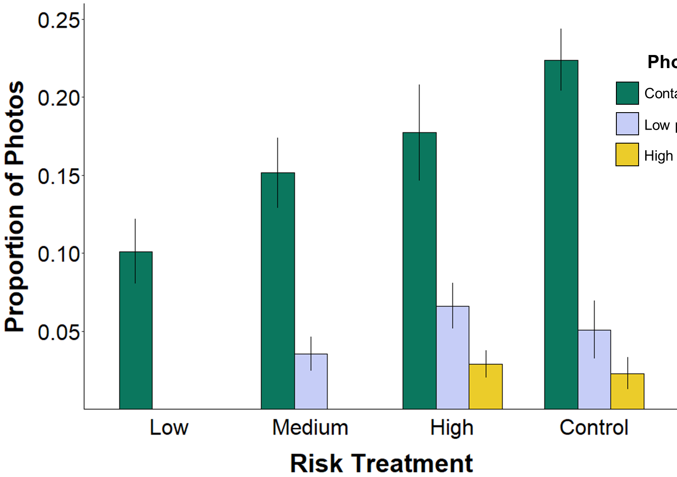
Comparable activity of predators among treatments
PERMANOVA
Treatment: P = 0.0099
PERMDISP: P = 0.0027
n (L, M, H, C) = 21, 20, 25, 4
Treatment: P = 0.91
PERMDISP: P = 0.89
n (M, H, C) = 20, 25, 4
Treatment: P = 0.99
PERMDISP: P = 0.81
n (H, C) = 25, 4
Notes:
Used PERMANOVA because data did not meet assumptions of normality and equal variance – there were a high number of photos that were scored as zero because they didn’t contain predators
Counts: seems like there are differences among treatments in the proportion of photos that contained predators, but there were also significant differences in the dispersion of the data (PERMDISP), so we can’t say for sure that

Slide 36
Summary of the effects of risk on bluebanded gobies
Reproduction
No measurable effect on egg production
Behavior
Lower exposure
Similar effects on courtship, foraging, and survival
Perceived risk of predators
Higher abundance with access
Similar visitation among comparable treatments
Notes:
Really only affected

Slide 37
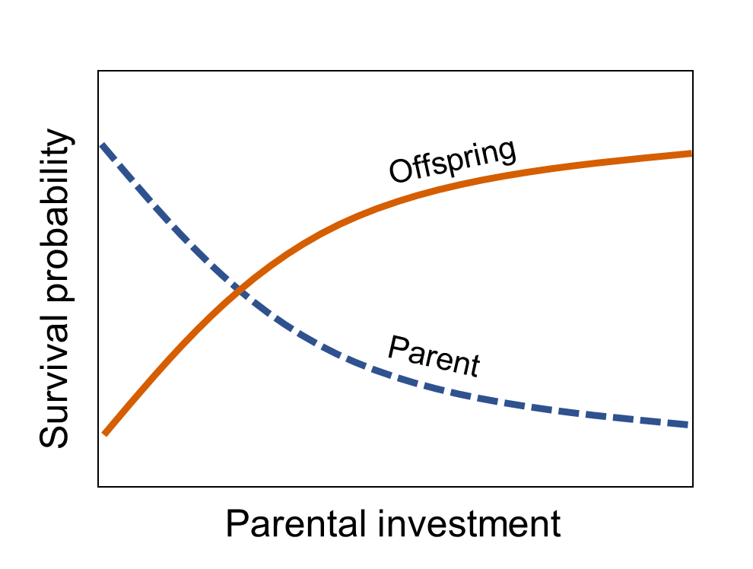
Implications and significance
Effects of predators may not have been severe enough to induce changes in fitness
Notes:
Talk here about how changes in exposure time were not severe enough to reduce foraging, or courtship, and those are likely the drivers of reproductive output
If there were higher predator abundances, and a higher proportion of predators perceived as a threat, we would likely see differences in courtship, and foraging that would result in lower fitness
Long-term version of this study would likely show same results, but if predator abundances were higher, I would expect to see suppressed fitness and likely higher-mortality from reduced foraging or more risky behavior in high-rick environments
3) likely due to low reproductive plasticity in BBG (only 2-year lifespan, and 8-mo repro span)
suppression could lead to severe reductions in lifetime fitness
a) Would not likely see same responses in a broadcast spawning fish (low reproductive investment), or a fish that has a longer reproductive span (able to allocate reproduction to a less risky period)

Slide 38
Implications and significance
Effects of predators may not have been severe enough to induce changes in fitness
Changes in fitness may not have been detectable in reproductive output
Notes:
Talk here about how changes in exposure time were not severe enough to reduce foraging, or courtship, and those are likely the drivers of reproductive output
If there were higher predator abundances, and a higher proportion of predators perceived as a threat, we would likely see differences in courtship, and foraging that would result in lower fitness
Long-term version of this study would likely show same results, but if predator abundances were higher, I would expect to see suppressed fitness and likely higher-mortality from reduced foraging or more risky behavior in high-rick environments
3) likely due to low reproductive plasticity in BBG (only 2-year lifespan, and 8-mo repro span)
suppression could lead to severe reductions in lifetime fitness
a) Would not likely see same responses in a broadcast spawning fish (low reproductive investment), or a fish that has a longer reproductive span (able to allocate reproduction to a less risky period)

Slide 39
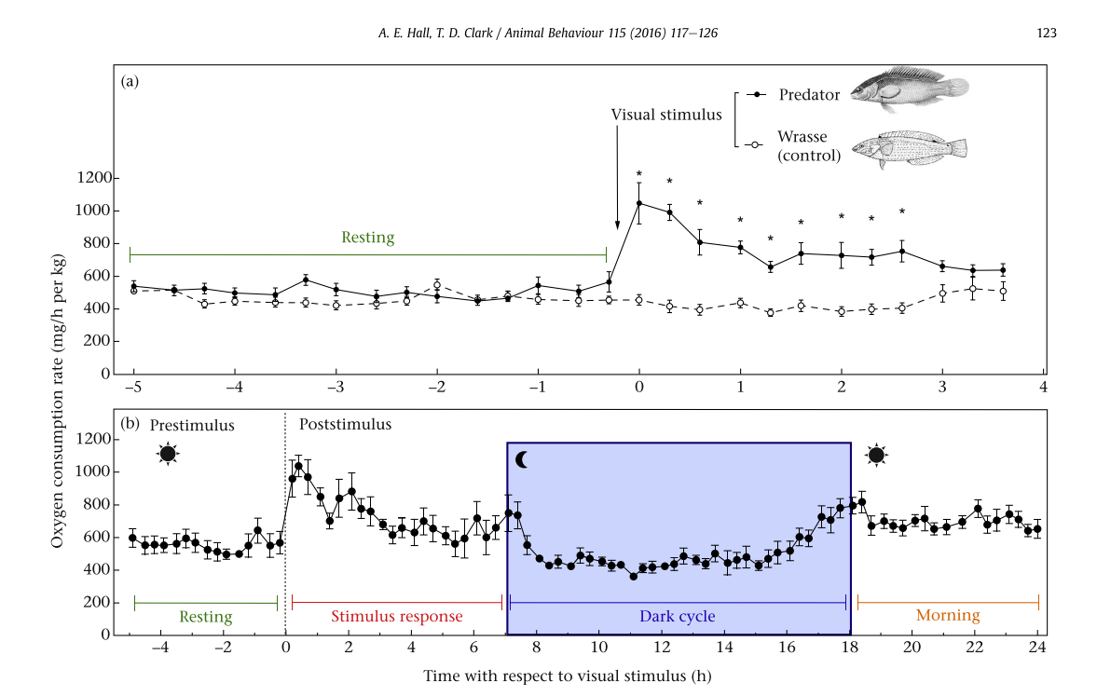
Risk affected metabolism but not behavior
Adapted from Hall and Clark 2016
Notes:
Effects of predators on behavior and metabolism in damselfish on coral reefs

Slide 40
Implications and significance
Effects of predators may not have been severe enough to induce changes in fitness
Changes in fitness may not have been detectable in reproductive output
Longer-term risk may lead to reductions in fitness over time
Reznick 1990, Heins et al. 2016
Notes:
Isolated populations (done before, may be representative of my patch reefs, but not likely) vs. open populations
My study took place over an ecological timescale, whereas the true effects of risk on demographic changes in bluebanded gobies may manifest themselves over evolutionary timescales

Slide 41
Implications and significance
Effects of predators may not have been severe enough to induce changes in fitness
Changes in fitness may not have been detectable in reproductive output
Longer-term risk may lead to reductions in fitness over time
Understanding responses to risk can help predict effects of predator removals or protection
Notes:
Isolated populations (done before, may be representative of my patch reefs, but not likely) vs. open populations
My study took place over an ecological timescale, whereas the true effects of risk on demographic changes in bluebanded gobies may manifest themselves over evolutionary timescales

Slide 42
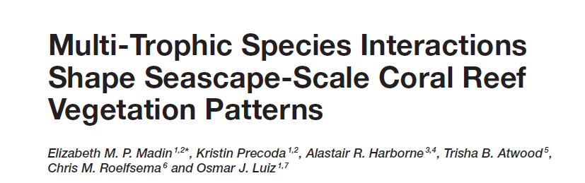
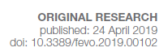


Slide 43










Acknowledgements
Steele Lab
Dr. Maria Adreani
Dr. Casey Benkwitt
Kathryn Scafidi
Ben Chubak
Erika Nava
Erin Jaco
Alexis Estrada
Russell Dauksis
Griffin Srednick
Barbara Weiser
Thesis committee
Dr. Mark Steele
Dr. Larry Allen
Dr. Casey terHorst
Research facilities
Undergraduate researchers
Emily Nixon
Hunter Ramo
Kyle Mooers
Lindsey Stockton
Taleen Gharibian
Michelle Barrios
*USC REU students
Funding organizations
Volunteer divers
Andrew Kerr
Holly Baijnauth
Max Liebergesell
Zoë Scott
Darrin Ambat
Amanda Heidt
Kenji Soto
Scott Miller
Additional support
Dr. Jameal Samhouri
Dr. Will White
Dr. Scott Hamilton
Dr. Catherine Matassa
Dr. Todd Anderson
Dr. Nyssa Silbiger
Dr. Adrian Stier
Stephen Pang

Slide 44

Questions?
Maurice Roper

Slide 45

Are bluebanded gobies fearless?
Effects of predators may not have been severe enough to induce changes in fitness
Reductions in fitness may not have been detectable in reproductive output
Longer-term risk may lead to reductions in fitness over time
Notes:
Talk here about how changes in exposure time were not severe enough to reduce foraging, or courtship, and those are likely the drivers of reproductive output
If there were higher predator abundances, and a higher proportion of predators perceived as a threat, we would likely see differences in courtship, and foraging that would result in lower fitness
Long-term version of this study would likely show same results, but if predator abundances were higher, I would expect to see suppressed fitness and likely higher-mortality from reduced foraging or more risky behavior in high-rick environments
3) likely due to low reproductive plasticity in BBG (only 2-year lifespan, and 8-mo repro span)
suppression could lead to severe reductions in lifetime fitness
a) Would not likely see same responses in a broadcast spawning fish (low reproductive investment), or a fish that has a longer reproductive span (able to allocate reproduction to a less risky period)

Slide 46

Equal reproduction among risk treatments
LMM, treatment: p = 0.19
n = 12
Notes:
Y = total egg production per reef after 1 month
X = risk treatment
Showing means and standard errors in figure
No legend needed, but mention that colors will be consistent throughout talk
Might not be statistical differences in output, but we see a trend of decreasing production with decreasing distance between predators and prey
Based on these results, might not expect to see differences in other responses. Let’s check out the surveys for mortality, first visual surveys, where I swam over each reef and counted the number of fish visible on each

Slide 47


Slide 48

Fewer gobies observed on high-risk reefs
GLM:
treatment*time: p = 0.66
time: p < 0.001
treatment: p < 0.001
Seen 21% less frequently on high-risk reefs
Notes:
Y = number of fish seen per reef
X = week of the survey
The number of gobies seen on the reefs decreased over time, regardless of risk
However, I consistently saw fewer gobies on high-risk reefs during the experiments, 21% reduction overall
As long as predators were excluded at all (low and medium risk treatments), no changes in number of fish seen
Don’t know if the reductions in high-risk treatment were due to lethal or sublethal effects, where predators were allowed full access

Slide 49

Similar recollections by sex
LMM
Fixed: treatment, sex
Random: deployment block
P = 6
No effect of risk on total number recollected (P = 0.153)
Equal sex ratios among treatments (P = 0.863)
Notes:
Recollected the same proportion of gobies from each of the three risk treatments, showing that it might not be lethal predation driving the reductions in reproductive output in the high risk treatments
This is interesting, similar final recollections as ending densities observed on reefs == confirms accuracy of visual counts
Recollected similar numbers of males and females, regardless of risk
Collected about 50% morel males than females

Slide 50
Experiments
2017
18 reefs (n=6)
week-long trials
2 days of nest sampling
2018:
June + July: month-long trials
nest sampling twice per week
August:
20 reefs, added cage control (n=5)
2-week trial
nest sampling twice per week

Slide 51


What I expected to see…

Slide 52


What I mostly saw…

Slide 53

Color codes:
Size
Pink = 20’s
Blue = 30’s
Orange = 40’s
no tag <20 mm
Sex
Pink = female
Blue = male
5
4
3
2
1

Slide 54
6
7
8
9
0

Slide 55
Risk from predators
Behavioral response
Physiological response
Reductions in fitness
Notes:
The effects of sublethal predation can manifest themselves differently, even if their effects on reproductive output are the same.
Also high likelihood that both of these processes are occurring at the same time when prey are affected by predators
My study only focuses on the potential behavioral responses of prey to predation risk, but I wanted to acknowledge that the effects of risk can manifest themselves in different ways,

Slide 56
Risk from predators
Behavior
Physiology
Reductions in fitness

